Slide 1
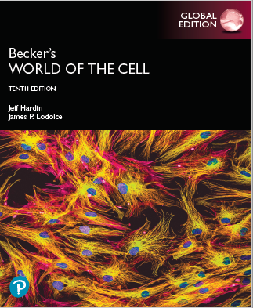
Becker’s World of the Cell
Tenth Edition, Global Edition
Chapter 12
The Endomembrane System and Protein Sorting
Lectures by Anna Hegsted, Simon Fraser University
Copyright © 2022 Pearson Education Ltd. All Rights Reserved.
Notes:
If this PowerPoint presentation contains mathematical equations, you may need to check that your computer has the following installed:
1) MathType Plugin
2) Math Player (free versions available)
3) NVDA Reader (free versions available)

Slide 2
Steps of Glycosylation (1 of 2)
Glycosylation begins as dolichol phosphate, an oligosaccharide carrier, is inserted into the E R membrane.
GlcNAc and mannose groups are then added to the phosphate group.
The growing core oligosaccharide is translocated to the ER lumen by a flippase.

Slide 3
Steps of Glycosylation (2 of 2)
Once inside the lumen, more mannose and glucose are added.
The completed core oligosaccharide is transferred from dolichol to the asparagine residue of the recipient protein.
The core oligosaccharide attached to the protein is trimmed and modified.

Slide 4
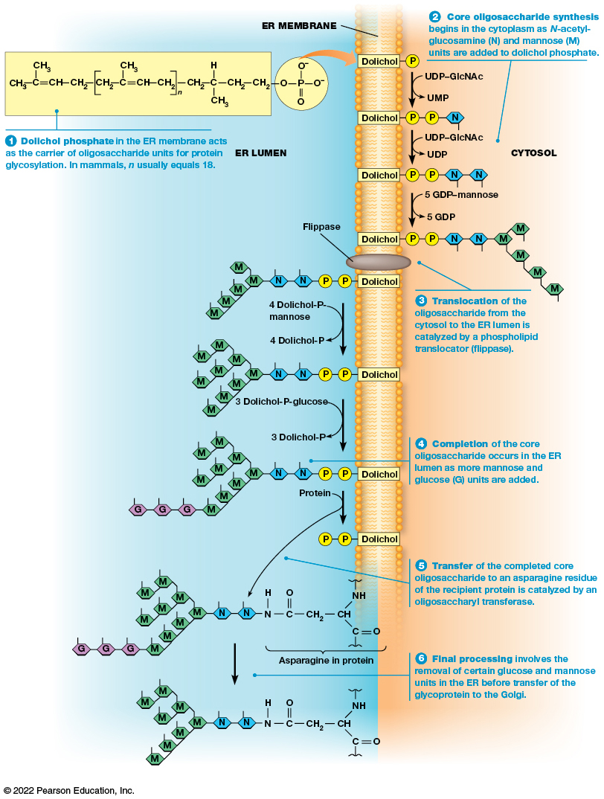
N-Linked Glycosylation of Proteins in the E R
Figure 12.6 N-Linked Glycosylation of Proteins in the E R.
Notes:
Long Description:
1. In ER lumen: Dolichol phosphate in the E R membrane acts as the carrier of oligosaccharide units for protein glycosylation. In mammals, n usually equals 18. The structure of dolichol is two C H subscript 3 each having with C double bond C H single bond C H subscript 2 single bond open square bracket C H subscript 2 single bond C single bond C H subscript 3 double bond C H single bond C H subscript 2 close square bracket base n single bond C H subscript 2 single bond C having three single bonds with H, C H subscript 3 and C H subscript 2 single bond C H subscript. This is liked with P of phosphate with 2 O negative, one O single bond, and one double bond with O.
2. In cytosol: Core oligosaccharide synthesis begins in the cytoplasm as N hyphen acetylglucosamine (N) and mannose (M) units are added to dolichol phosphate.
The following conversions happen:
a. Dolichol P to Dolichol P P N while U D P hyphen G l c N A c to U M P happens.
b. Dolichol P P N to Dolichol P P N N while U D P hyphen G l c N A c to U D P happens.
c. Dolichol P P N N to Dolichol P P N N five M molecules while five G D P hyphen mannose to five G D P happens.
3. In ER lumen: Translocation of the oligosaccharide from the cytosol to the E R lumen is catalyzed by a phospholipid translocator (flippase).
The following conversions happen
a. Dolichol P P N N five M molecules to Dolichol P P N N nine M molecules while four Dolichol hyphen P hyphen mannose is converted to four dolichol hyphen P.
b. Dolichol P P N N nine M molecules to Dolichol P P N N nine M molecules three G while three Dolichol hyphen P hyphen glucose is converted to three Dolichol hyphen P.
4. Completion of the core oligosaccharide occurs in the ER lumen as more mannose and glucose (G) units are added.
a. Structure of protein has the asparagine in protein two N nine M three G.
5. Transfer of the completed core oligosaccharide to an asparagine residue of the recipient protein is catalyzed by an oligosaccharyltransferase.
a. Structure of asparagine in protein is C H has three single bond with N H, C double bond O and C H subscript 2 single bond C double bond O single bond N single bond H.
6. Final processing involves the removal of certain glucose and mannose units in the E R before transfer of the glycoprotein to the Golgi.
a. The protein structure becomes C H has three single bond with N H, C double bond O and C H subscript 2 single bond C double bond O single bond N single bond H two N and nine M.

Slide 5
Cotranslational Glycosylation
Usually the oligosaccharide is added to the recipient protein as the polypeptide is being synthesized.
This is called cotranslational glycosylation.
It helps to promote proper protein folding.

Slide 6
Two Proteins Assist with Proper Folding
Two E R proteins, calnexin (C N X) and calreticulin (C R T), bind to monoglucosylated glycoproteins and promote proper folding.
This occurs via a complex that includes a thiol reductase known as E R p57.
The complex dissociates and the final glucose is removed by glucosidase Ⅱ.

Slide 7
Proper Folding in the E R
A glucosyl transferase, U G G T (U D P-glucose:glycoprotein glucotransferase), binds to improperly folded proteins.
It adds back a single glucose unit, making the protein a substrate for C N X / C R T binding.
Once proper conformation is achieved, UGGT no longer binds the new glycoprotein, which moves on to the Golgi.

Slide 8
Further Glycosylation Occurs in the Golgi Apparatus
Further processing of N-glycosylated proteins occurs in the Golgi complex as the glycoproteins move from the cis face through to the trans face.
These terminal glycosylations are variable and create great diversity.
Terminal glycosylation involves the removal of a few units of the core oligosaccharide and sometimes nothing more.

Slide 9
Terminal Glycosylation
In some cases, more complex oligosaccharides are generated by adding G l c N A c or other monosaccharides.
Sometimes galactose units are added by galactosyl transferase.
The E R and Golgi contain hundreds of different glycosyl transferases.

Slide 10
12.4 Roles of the E R and Golgi Apparatus in Protein Trafficking
Proteins synthesized in the rough E R must be directed to a variety of locations.
Once a protein reaches its destination, it must be prevented from leaving.
Each protein contains a specific “tag” targeting it to a transport vesicle that will take it to the correct location.

Slide 11
Protein Tags
A tag may be an amino acid sequence, a hydrophobic domain, oligosaccharide side chain, or some other feature.
Tags can also exclude material from certain vesicles.

Slide 12
Overview: Nuclear Gene to Synthesized Polypeptide
Tagged polypeptides encoded by nuclear genes begin with transcription of DNA into RNAs. These R N A s are processed in the nucleus (becoming mRNAs) and then transported to the cytoplasm.
mRNAs associate with free ribosomes in the cytoplasm and translation begins.
Shortly after translation begins, two pathways for sorting the synthesizing polypeptide diverge.

Slide 13
Two Pathways for Sorting Tagged Polypeptides (1 of 3)
Pathway for polypeptides destined for the cytosol, mitochondria, chloroplast, peroxisome, and nuclear interior:
Free ribosomes synthesize these polypeptides.
After translation, the polypeptide is released. It remains in the cytosol or an organelle takes it up.
Posttranslational import is the uptake of completed polypeptides with special targeting signals into the organelle.

Slide 14
Two Pathways for Sorting Tagged Polypeptides (2 of 3)
Pathway for polypeptides destined for the endomembrane system or export from the cell:
The ribosome synthesizing these polypeptides attach to the E R membrane.
The polypeptide is transferred across (or for integral membrane proteins, inserted into) the E R membrane as synthesis occurs. This is called cotranslational import.

Slide 15
Two Pathways for Sorting Tagged Polypeptides (3 of 3)
Pathway for polypeptides destined for the endomembrane system or export from the cell (continued):
These proteins can be directed to the ER, Golgi apparatus, endosomes and lysosome. There is also a mechanism to maintain the protein in these locations. Other proteins are incorporated in the plasma membrane or released outside the cell.

Slide 16
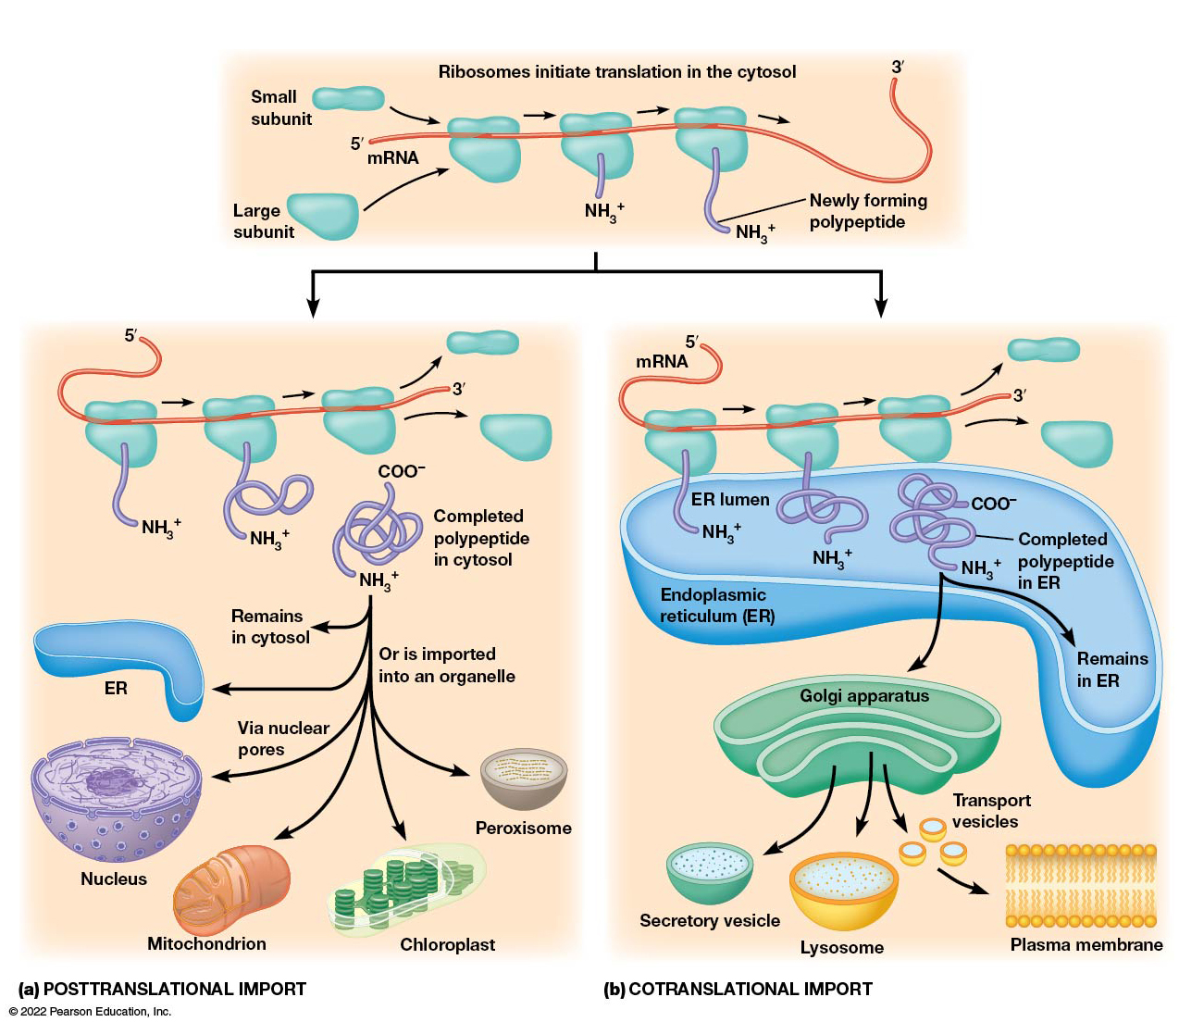
Intracellular Sorting of Proteins
Figure 12.7 Intracellular Sorting of Proteins.
Notes:
Long Description:
The details of the sorting of proteins are as follows:
Posttranslational import and cotranslational import. Ribosomes initiate translation in the cytosol. The small subunits are on side of the m R N A strand which has a 5 dash and a 3 dash end, and the large subunits on the other.
The large subunits contribute to polypeptide. The newly forming polypeptide follows the route of either posttranslational import or cotranslational import.
Posttranslational import: The newly formed completed polypeptides in cytosol have C O O negative at one end and N H subscript 3 positive at the end of the strand. This polypeptide remains in cytosol, in E R, in nucleus via nuclear pores, in mitochondrion, in chloroplast, in peroxisome, or is imported into an organelle.
Cotranslational import: Ribosomes with N H subscript 3 positive attach to E R lumen. Completed polypeptide in E R with N H subscript 3 positive at one end and C O O negative at the other end. The newly formed polypetide is transferred across the E R membrane into the Golgi apparatus, secretory vesicle, lysosome, and plasma membrane as transport vesicles. The remains are found in the E R.

Slide 17
Trafficking Through the Endomembrane System: Anterograde Direction (1 of 2)
Ribosomes of the rough E R synthesize proteins. These proteins enter the E R lumen and initial glycosylation steps occur.
Transition vesicles carry glycosylated proteins and lipids to the CGN.
Lipids and proteins move through the cisternae of the Golgi apparatus.

Slide 18
Trafficking Through the Endomembrane System: Anterograde Direction (2 of 2)
At the T G N:
Secretory vesicles are formed, which release their contents to the plasma membrane by exocytosis.
Vesicles bud to form endosomes that help make lysosomes.

Slide 19
Trafficking Through the Endomembrane System: Retrograde Direction
Proteins and other materials can be brought into the cell via endocytosis. Vesicles formed by endocytosis fuse with early endosomes.
Early endosomes containing digestive materials mature into late endosomes and then lysosomes.
Retrograde traffic returns compartment specific proteins to earlier compartments.

Slide 20
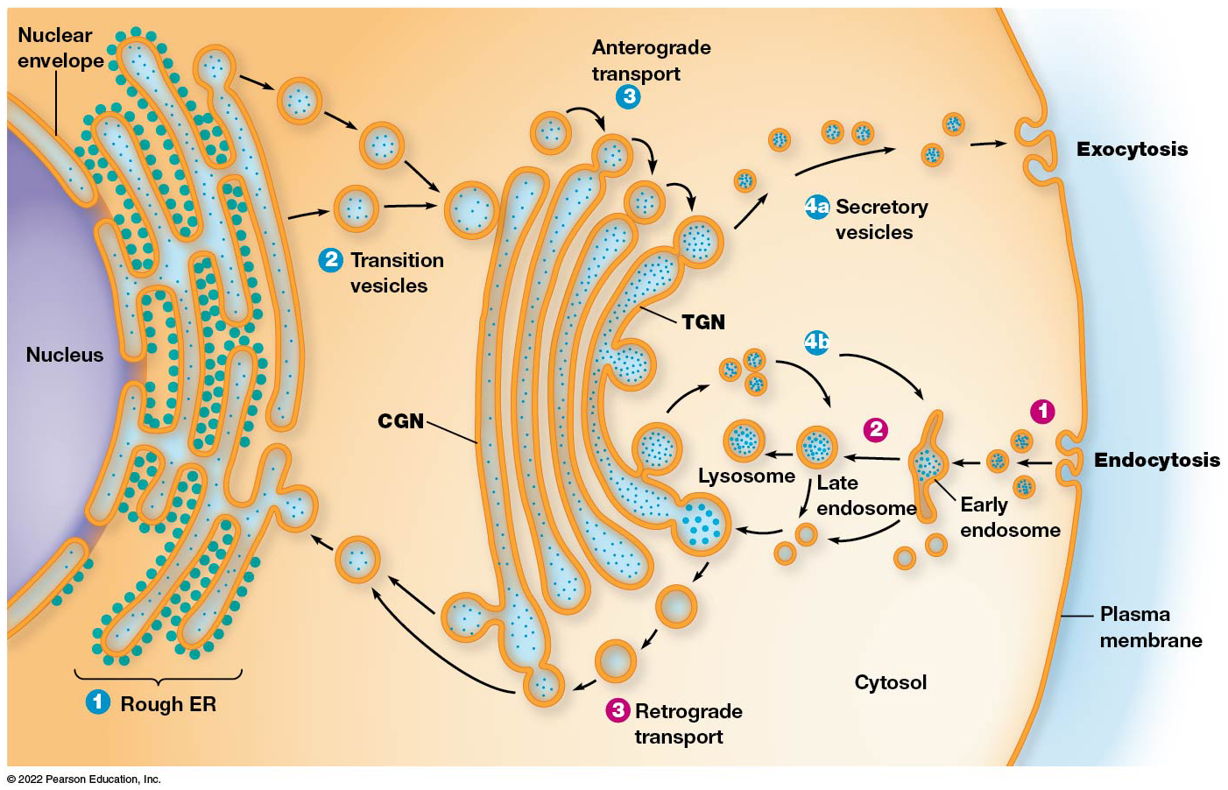
Trafficking Through the Endomembrane System
Figure 12.8 Trafficking Through the Endomembrane System.
Notes:
Long Description:
1. Anterograde transport
The direction is from rough E R with ribosomes on it to transition vesicles to C G N of Golgi apparatus to T G N. From here, there are two routes. The first route “4a” is from T G N to secretory vesicles to outside the cell through exocytosis. The second route “4b” is through T G N through late endosome or early endosome to T G N back forming a loop.
2. Retrograde transport
The direction is from outside the cell to the cytosol through endocytosis of plasma membrane. Then to the early endosome, late endosome, lysosome, T G N, C G N of Golgi apparatus, and endoplasmic reticulum.

Slide 21
Cotranslational Import Allows Some Polypeptides to Enter the E R as They Are Being Synthesized
Cotranslational import is the first step in the pathway for delivering proteins to various locations in the endomembrane system.
Proteins trafficked this way are synthesized on ribosomes become attached to the E R after translation has begun.

Slide 22
The Role of the E R in Protein Synthesis (1 of 2)
The role of the E R in protein synthesis was elucidated when microsomes, vesicles of rough E R, were isolated by subcellular fractionation and centrifugation.
The microsomes were incubated with components needed for protein synthesis, including radioactive amino acids.
Protein synthesis was stopped using puromycin, an antibiotic that causes partially completed polypeptides to be released from ribosomes.

Slide 23
The Role of the E R in Protein Synthesis (2 of 2)
The ribosomes and membrane vesicles were separated and many of the radioactive polypeptides were found in the vesicle.
Conclusion: newly formed polypeptides pass into the E R lumen as they are being synthesized. This allows the protein to be routed through the E R to the correct destination.

Slide 24
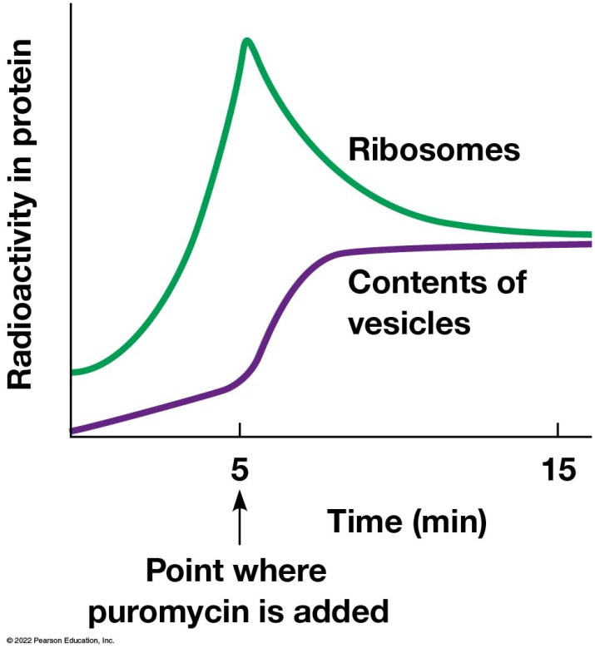
Evidence That Proteins Synthesized on Ribosomes Attached to E R Membranes Pass Directly into the E R Lumen
Figure 12.9 Evidence That Proteins Synthesized on Ribosomes Attached to E R Membranes Pass Directly into the E R Lumen.
Notes:
Long Description:
The X axis shows time in minutes and Y axis shows radioactivity in protein. Ribosomes start with higher radioactivity in protein than the contents of vesicles. At 5 minutes, when puromycin is added, ribosomes show a higher spike and drops down to a constant immediately. The radioactivity in protein in contents of vesicles rise up and goes to a constant.

Slide 25
Signal Hypothesis
Signal hypothesis: for polypeptides destined for the E R, the N-terminus contains an E R signal sequence that directs ribosome-mRNA-polypeptide complexes to the surface of the rough E R.
Then as the polypeptide chain elongates, it progressively crosses the E R membrane and enters the E R lumen.
Proteins containing the E R signal sequences are often called preproteins (prelysozyme or preproinsulin).

Slide 26
E R Signaling Sequences
Amino acid sequence is variable but has some unifying factors:
15–30 amino acids long
Three domains: a positively charged N-terminal region, a central hydrophobic region, and a polar region next to the cleavage site.
The E R signaling sequence must be present for the polypeptide to be inserted into or across the membrane.

Slide 27
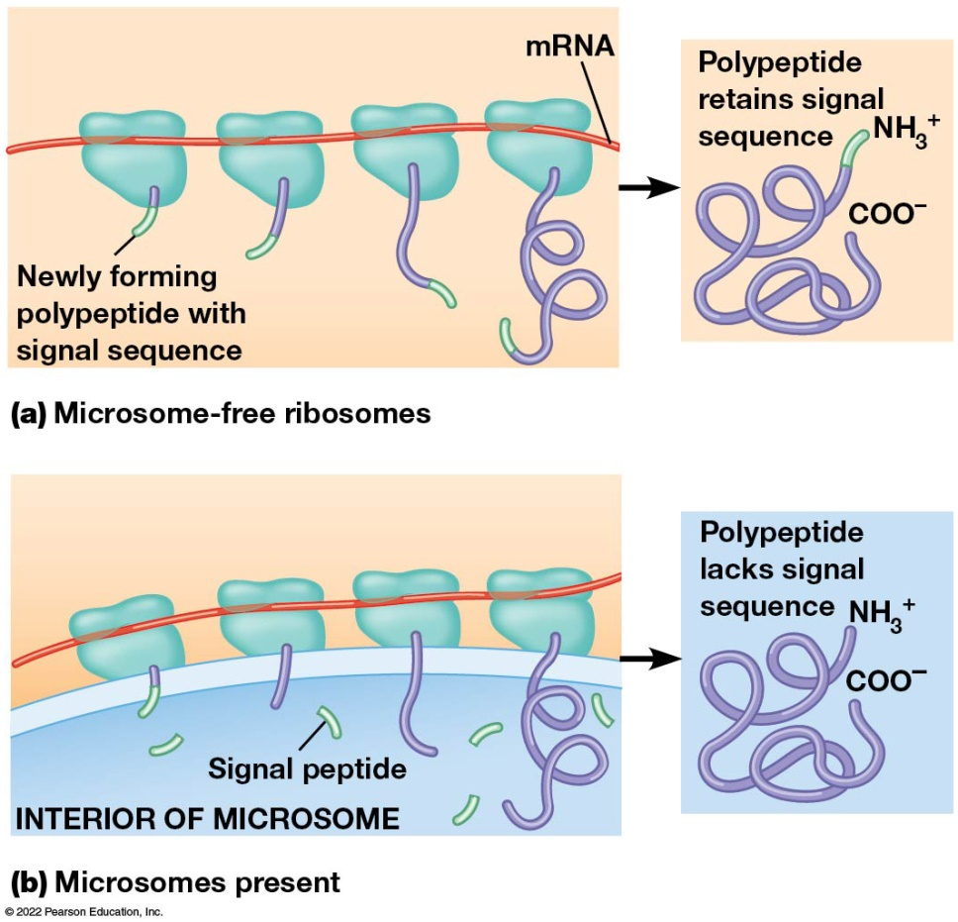
Evidence That Cotranslational Insertion into the E R Is Required for Normal Processing of Secreted Proteins
Figure 12.10 Evidence That Cotranslational Insertion into the E R Is Required for Normal Processing of Secreted Proteins.
Notes:
Long Description:
Microsome-free ribosomes: Newly forming polypeptide with signal sequence attached to it. Polypeptide retains signal sequence with N H subscript 3 positive on one end and C O O negative on the other end.
Microsomes present: The signal peptide is split from the polypeptide in the interior of microsome. Polypeptide with N H subscript 3 positive at one end and C O O negative at the other end lacks signal sequence.

Slide 28
The Signal Recognition Particle (S R P) Attaches the Ribosome-m R N A-Polypeptide Complex to the E R Membrane
The E R signal sequence does not initiate contact of the ribosome with the E R.
Contact of the ribosome with the E R is mediated by the signal recognition particle (S R P).
The S R P recognizes and binds to the E R signal sequence and then binds to the E R membrane.

Slide 29
The S R P Mechanism of Cotranslational Import
m R N A binds to a free ribosome. The polypeptide is synthesized until the E R signal sequence has been formed.
S R P binds the E R signal sequence and blocks translation.
The S R P binds the ribosome to a translocon in the E R membrane.
A translocon is a structure in the E R membrane that is responsible for the translocation of polypeptides across the E R membrane.

Slide 30
The S R P Mechanism of Cotranslational Import: Step 1
m R N A binds to a free ribosome. The polypeptide is synthesized until the E R signal sequence has been formed.
S R P binds the E R signal sequence and blocks translation.
The S R P binds the ribosome to a translocon in the E R membrane, a structure in the E R membrane that is responsible for the translocation of polypeptides across the E R membrane.

Slide 31
The S R P Mechanism of Cotranslational Import: Translocon
The translocon is a protein complex composed of:
S R P receptor, to which S P R binds
Ribosome receptor, that holds the ribosome in place
Pore protein, that forms a channel for the growing polypeptide to enter the E R lumen
Signal peptidase, an enzyme to remove the E R signal sequence

Slide 32
The S R P Mechanism of Cotranslational Import: Steps 2–4
S R P binds the S R P receptor and the ribosome becomes attached to the ribosome receptor.
G T P binds S R P and S R P receptor, unblocking translation and causing transfer of the signaling sequence to the pore protein. The core of the pore is made of the Sec61 complex.
G T P is hydrolyzed and S R P is released.

Slide 33
The S R P Mechanism of Cotranslational Import: Steps 5 and 6
The elongating peptide passes into the ER lumen and signal peptidase cleaves the ER signal sequence.
After the polypeptide synthesis is complete, the polypeptide is released into the lumen, the translocon channel is closed, and the ribosome detaches from the ER membrane, dissociates into it subunits and releases the m R N A.

Slide 34
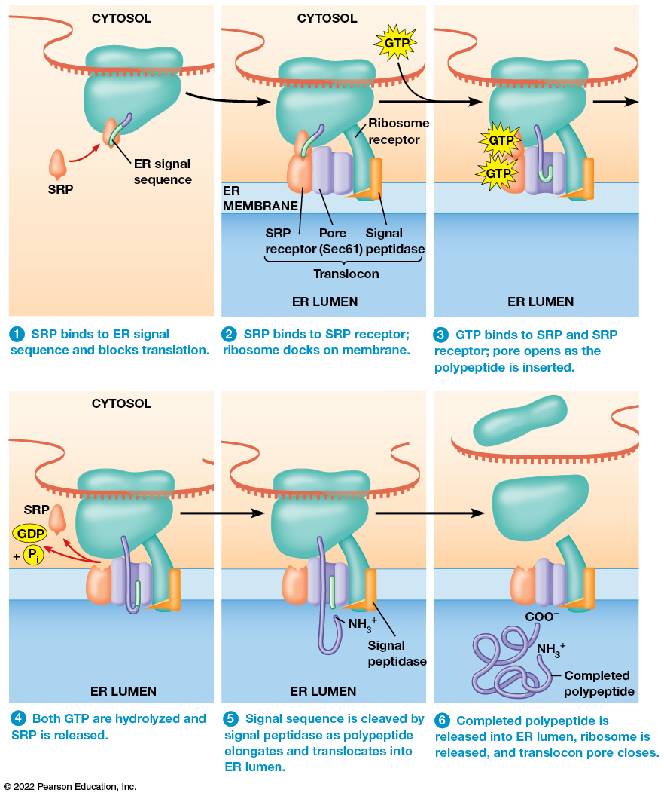
The Signal Mechanism of Cotranslational Import
Figure 12.11 The Signal Mechanism of Cotranslational Import.
Notes:
Long Description:
The steps are as below:
1. S R P binds to E R signal sequence and blocks translation.
2. S R P binds to S R P receptor; ribosome docks on membrane. The parts labeled are ribosome receptor and translocon, which has S R P receptor, pore sec 6 1, and signal peptidase.
3. G T P binds to S R P and S R P receptor; pore opens as the polypeptide is inserted.
4. Both G T P are hydrolyzed and S R P is released. G D P plus inorganic phosphate are also released.
5. Signal sequence is cleaved by signal peptidase as polypeptide elongates and translocates into E R lumen. The free end of the polypoeptide is N H subscript 3 positive as the signal sequence is cut off.
6. Completed polypeptide is released into ER lumen, ribosome is released, and translocon pore closes. The free ends of the polypeptide area C O O negative and N H subscript 3 positive.

Slide 35
Proteins Released into the ER Lumen Are Routed to the Golgi Apparatus, Secretory Vesicles, or Back to the ER (1 of 2)
Most proteins synthesized on ribosomes attached to the E R are glycoproteins.
Glycosylation and folding occurs in the E R. The glycoprotein is then delivered to the Golgi apparatus for further glycosylation and processing of carbohydrate side chains.
The Golgi apparatus then sorts and distributes the proteins.

Slide 36
Proteins Released into the ER Lumen Are Routed to the Golgi Apparatus, Secretory Vesicles, or Back to the ER (2 of 2)
Soluble proteins go from the Golgi, to secretory vesicles, to the plasms membrane where the protein is secreted.
Or soluble proteins possess specific carbohydrate side chains or amino acid sequences that target them from the Golgi to other parts of the endomembrane system.
E R-bound proteins have a specific C-terminal tag.

Slide 37
ER-Specific Proteins Contain Retention and Retrieval Tags
Protein composition in the E R is maintained by preventing some proteins from escaping the E R and by retrieving others from the Golgi.
Some proteins localized to the E R contain the sequence RXR (Arg-X-Arg; X is any amino acid).
This is a retention tag and is also found in some proteins that are destined for the plasma membrane.

Slide 38
The RXR Tag
The N-methyl-D-aspartate (N M D A) receptor, important in mammalian neurotransmission, has the R X R tag.
It is thought that the tripeptide causes subunits of N M D A to be retained in the E R until the complex is completely assembled.
The R X R tag must be masked to allow the assembled complex to leave the E R.

Slide 39
Retrieval Tags
Some proteins returned from the Golgi to the E R contain retrieval tags.
The tags are short C-terminal sequences such as K D E L (Lys-Asp-Glu-Leu) or K K X X in mammals and H D E L (His-Asp-Glu-Leu) in yeast.
When a protein with this tag binds a receptor, the receptor-ligand complex is packaged into a transport vesicle for return to the E R.

Slide 40
Evidence Regarding Retrieval Tags
Evidence about the importance of retrieval tags comes from experiments involving chimeric proteins (fusion proteins).
These are made by joining the D N A sequences for two polypeptide segments to allow production of a hybrid protein.
Proteins normally secreted from the cell that are altered to contain the retrieval tag end up in the E R.

Slide 41
Golgi Apparatus Proteins May Be Sorted According to the Lengths of Their Membrane-Spanning Domains
Some proteins resident to the Golgi complex also contain retention or retrieval tags.
Large complexes that are excluded from transport vesicles may play a role in maintaining the protein composition of the Golgi complex.
A third mechanism involves hydrophobic regions of Golgi proteins.

Slide 42
Golgi-Specific Proteins
All Golgi-specific proteins are integral membrane proteins with one or more membrane-spanning domains.
The length of the hydrophobic domains may determine into which cisternae each protein is incorporated.
The thickness of cellular membranes increases progressively from the E R (5 nm) to the plasma membrane (8 nm).

Slide 43
Length of Hydrophobic Domains Is Correlated with Location in the Golgi Complex
The thickness of membranes in the Golgi increases from the C G N to the T G N.
Proteins move from compartment to compartment until the membrane thickness exceeds the length of the transmembrane domains.
This blocks further migration.

Slide 44
Targeting of Soluble Lysosomal Proteins to Endosomes and Lysosomes Is a Model for Protein Sorting in the T G N
Soluble lysosomal enzymes in the E R and early Golgi compartments undergo N-glycosylation followed by removal of glucose and mannose units.
The mannose residues on the side chains are phosphorylated within the Golgi complex, forming an oligosaccharide containing mannose-6-phosphate.
This tag ensures delivery of lysosomal proteins to the lysosomes.

Slide 45
Targeting of Lysosomal Proteins to Endosomes and Lysosomes by Mannose-6-Phosphate Tag (1 of 3)
E R: soluble lysosomal enzymes are N-glycosylated. Glucose and mannose units are removed.
Golgi apparatus: mannose is phosphorylated by two Golgi specific enzymes.
Early compartment of the Golgi stack: phosphotransferase adds G l c N A c-1-phosphate.
Mid-Golgi: a second enzyme removes G l c N A c. A mannose-6-phosphate remains.

Slide 46
Targeting of Lysosomal Proteins to Endosomes and Lysosomes by Mannose-6-Phosphate Tag (2 of 3)
T G N: mannose-6-phosphate tagged enzymes bind mannose-6-phosphate receptors (M P R).
The receptor-ligand complex is packaged into a vesicle and conveyed to an early endosome.
Early endosome matures into a late endosome. The p H decreases causing the receptor and enzyme to separate.

Slide 47
Targeting of Lysosomal Proteins to Endosomes and Lysosomes by Mannose-6-Phosphate Tag (3 of 3)
The receptor are recycled in vesicles to the T G N.
The late endosome either matures into a lysosome or delivers its content to an active lysosome.

Slide 48
Multivesicular Endosomes
Degradation and recycling of unneeded or damaged components are carried out by specialized late endosomes called multivesicular endosomes (M V E s).
They are sometimes called multivesicular bodies (M V B s).
These serve as an intermediate between early endosomes and lysosomes and sequester materials destined for degradation or recycling.

Slide 49
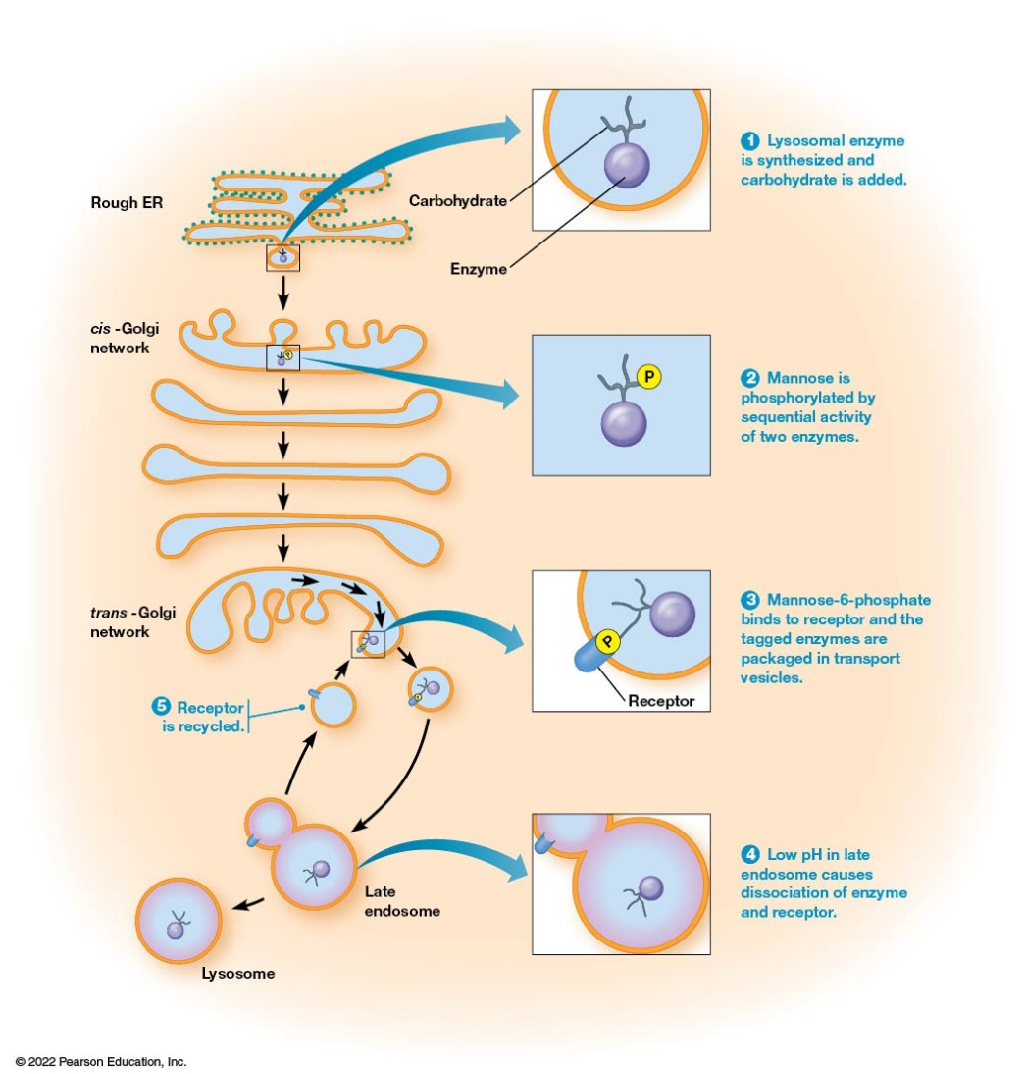
Targeting of Soluble Lysosomal Enzymes to Endosomes and Lysosomes by Mannose-6-Phosphate Tag
Figure 12.12 Targeting of Soluble Lysosomal Enzymes to Endosomes and Lysosomes by a Mannose-6-Phosphate Tag.
Notes:
Long Description:
The steps are in detail as below:
1. Lysosomal enzyme is synthesized and carbohydrate is added. Rough E R shows carbohydrate and enzyme.
2. Mannose is phosphorylated by sequential activity of two enzymes. The cis hyphen Golgi network shows phosphate molecule attached to the mannose.
3. Mannose hyphen six hyphen phosphate binds to receptor and the tagged enzymes are packaged in transport vesicles. The trans hyphen Golgi network shows Phosphate attached to the receptor.
4. Low p H in late endosome causes dissociation of enzyme and receptor. Two connected molecules in late endosome together form a lysosome.
5. Receptor is recycled.

Slide 50
Stop-Transfer Sequences Mediate the Insertion of Integral Membrane Proteins
The polypeptide of integral membrane proteins are synthesized like the soluble proteins. However, the completed polypeptide chain remains in the E R membrane.
Two main mechanisms to anchor newly formed polypeptide chains to the lipid bilayer of the E R membrane.

Slide 51
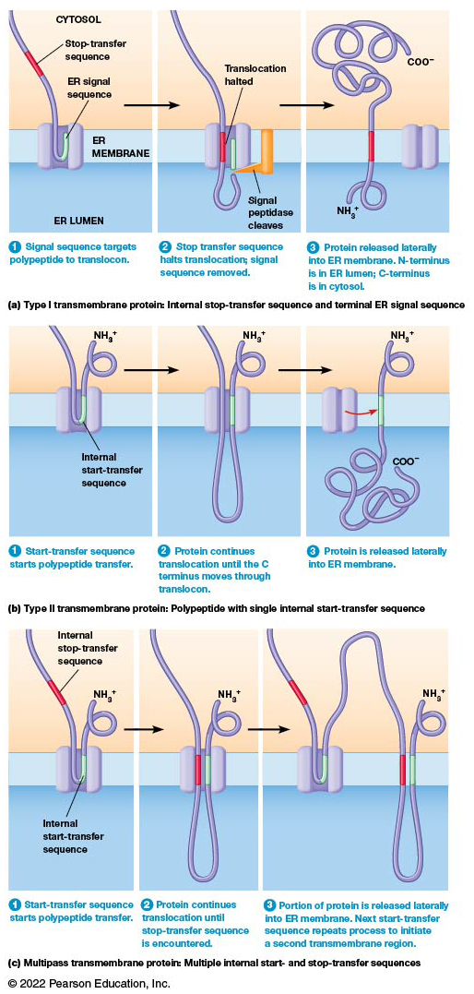
Cotranslational Insertion of Transmembrane Proteins into the ER Membrane
Figure 12.13 Cotranslational Insertion of Transmembrane Proteins into the ER Membrane.
Notes:
Long Description:
The details are as below:
1. Type I transmembrane protein: Internal stop-transfer sequence and terminal E R signal sequence
a. Signal sequence targets polypeptide to translocon. The E R signal sequence is within the channel attached to the protein in the E R membrane. The stop-transfer sequence is attached to the protein in the cytosol.
b. Stop transfer sequence halts translocation; signal sequence removed. The stop-transfer sequence goes to the E R membrane where the translocation is halted as the signal peptidase cleaves.
c. Protein released laterally into E R membrane. N hyphen terminus is in E R lumen; C hyphen terminus is in cytosol. The C O O negative end of the polypeptide is in the cytosol and the N H subscript 3 positive end is in the E R lumen.
2. Type II transmembrane protein: Polypeptide with single internal start hyphen transfer sequence
a. Start hyphen transfer sequence starts polypeptide transfer. The N H subscript 3 positive end is in the cytosol and internal start hyphen transfer sequence in the channel in the E R membrane.
b. Protein continues translocation until the C terminus moves through translocon. The peptide chain grows longer in the E R lumen.
c. Protein is released laterally into E R membrane. The start hyphen transfer sequence is shifted out of the channel and the C O O negative end is in the E R lumen.
3. Multipass transmembrane protein: Multiple internal start hyphen and stop hyphen transfer sequences
a. Start hyphen transfer sequence starts polypeptide transfer. The internal stop hyphen transfer sequence is in the cytosol and the internal start hyphen transfer sequence is within the channel of the E R membrane. The N H subscript 3 positive end is in the cytosol.
b. Protein continues translocation until stop hyphen transfer sequence is encountered. The N H subscript 3 positive end is in the cytosol and the peptide chain extends into the E R lumen.
c. Portion of protein is released laterally into E R membrane. Next start hyphen transfer sequence repeats process to initiate a second transmembrane region. The protein peptide chain lengthens into the cytosol and then into the E R lumen and then into the cytosol with the N H subscript 3 positive end.

Slide 52
Stop-Transfer Sequences (1 of 2)
The first mechanism involves polypeptides with an E R signal sequence at their N-terminus.
This allows an S R P to bind the ribosome-m R N A complex to the E R membrane.
Elongation of the polypeptide continues until the hydrophobic transmembrane domain is synthesized.

Slide 53
Stop-Transfer Sequences (2 of 2)
The hydrophobic amino acids function as a stop-transfer sequence.
The stop-transfer sequence halts translocation of the polypeptide through the E R membrane; as translation continues, the rest of the polypeptide stays on the cytosolic side of the E R membrane.
The stop-transfer sequence moves laterally, forming a permanent transmembrane segment.

Slide 54
Internal Start-Transfer Sequences
The second mechanism involves membrane proteins without a typical signal sequence at the N-terminus.
Instead, these proteins have an internal start-transfer sequence that S R P binds and targets to the E R membrane.
Then its hydrophobic region functions as a membrane anchor.

Slide 55
Proteins with Seven Membrane-Spanning Domains
Many important receptor proteins have seven membrane-spanning domains.
The basic mechanism involves the alternating activity of start-transfer and stop-transfer sequences.
These thread each transmembrane segment into the E R membrane.
The process continues until all transmembrane segments are inserted.

Slide 56
Multipass Transmembrane Protein
The first transmembrane sequence is inserted via an internal start-transfer sequence.
A stop-transfer sequence halts insertion and releases its first section of membrane-spanning amino acids laterally into the E R membrane.
The next start-transfer sequence is threaded into the translocon and continues until the next stop-transfer sequence. This process continues until all the membrane-spanning sections are inserted.

Slide 57
The Fate of Transmembrane Proteins
Once the polypeptide has been incorporated into the E R membrane, it can remain in place to function as an E R protein.
Alternatively, it can be transported to other components of the endomembrane system.
Transport to the appropriate compartment is carried out by a series of membrane budding and fusion events.

Slide 58
Posttranslational Import Is an Alternative Mechanism for Import into the E R Lumen
Some proteins are synthesized in the cytosol and subsequently transported into the E R lumen.
This posttranslational import occurs by a process similar to cotranslational import.
As the protein is synthesized, it associates with Hsp70 family chaperones, which initially keep the protein unfolded.

Slide 59
Process of Posttranslational Import
A complex of E R membrane proteins (Sec62, 63, 71, and 72) associated with the Sec61 pore targets the protein for translocation.
The protein moves through the pore, losing the associated chaperones.
The Sec protein also recruits BiP to the site of emergence into the E R lumen.
The B i P couples A T P hydrolysis to stepwise pulling of the polypeptide into the E R lumen.

Slide 60
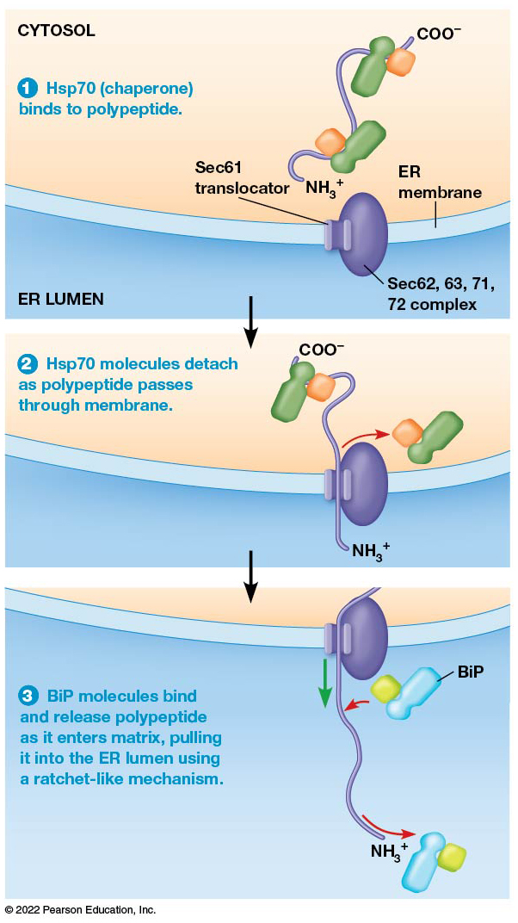
Posttranslational Import of Polypeptides into the E R Lumen
Figure 12.14 Posttranslational Import of Polypeptides into the E R Lumen.
Notes:
Long Description:
The steps are as below:
1. H s p 7 0 (chaperone) binds to polypeptide. Both the C O O negative and N H subscript 3 positive ends are in the cytosol.
2. H s p 7 0 molecules detach as polypeptide passes through membrane. The N H subscript 3 positive end goes through the E R membrane into the E R lumen.
3. B i P molecules bind and release polypeptide as it enters matrix, pulling it into the E R lumen using a ratchet-like mechanism.

Slide 61
12.5 Exocytosis and Endocytosis: Transporting Material Across the Plasma Membrane
Two methods (unique to eukaryotes) for transporting materials across the plasma membrane are:
Exocytosis, the process by which secretory vesicles release their contents outside the cell
Endocytosis, the process by which cells internalize external materials

Slide 62
Secretory Pathways Transport Molecules to the Exterior of the Cell
Secretory pathways move proteins from the E R through the Golgi complex to secretory vesicles and secretory granules.
The secretory granules then discharge their contents to the exterior of the cell.
Experiments using microscopic autoradiography to show the movement of proteins through secretory pathways.

Slide 63
Results of the Experiment (1 of 2)
Proteins were radioactively labeled briefly.
After three minutes, the labeled proteins could be seen primarily in the rough E R.
A few minutes later, the labeled proteins began to appear in the Golgi apparatus.

Slide 64
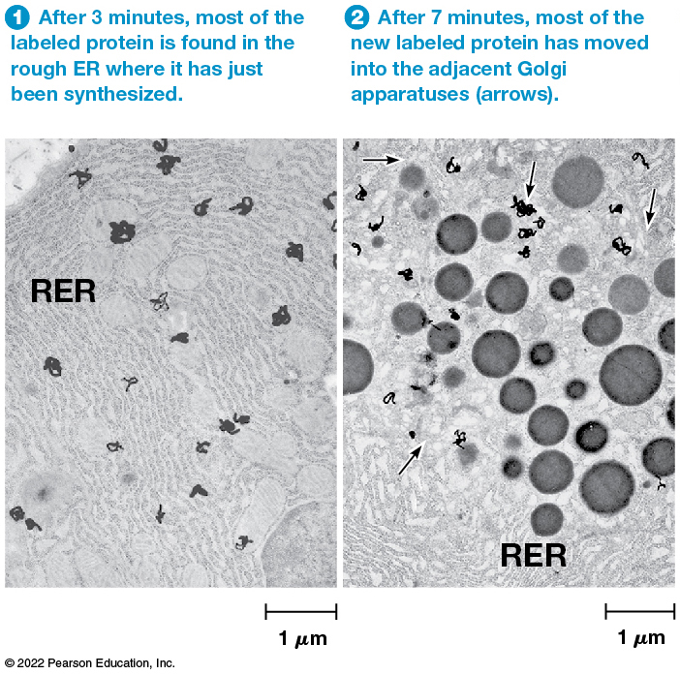
Autoradiographic Evidence of the Secretory Pathway: 3 and 7 Minutes After Radiolabeling
Figure 12.15 Autoradiographic Evidence of a Secretory Pathway.
Notes:
Long Description:
After 3 minutes, most of the labeled protein is found in the rough E R where it has just been synthesized.
After 7 minutes, most of the new labeled protein has moved into the adjacent Golgi apparatuses.
After 37 minutes, the labeled protein is being concentrated in condensing vacuoles next to the Golgi.
After 117 minutes, the labeled protein is found in zymogen granules, ready for export from the cell to the lumen.

Slide 65
Results of the Experiment (2 of 2)
After 37 minutes, the protein was detected in vesicles budding from the Golgi (named condensing vacuoles by the researchers).
After 117 minutes, the protein began to accumulate in dense zymogen granules, vesicles that discharge their contents out of the cell.

Slide 66
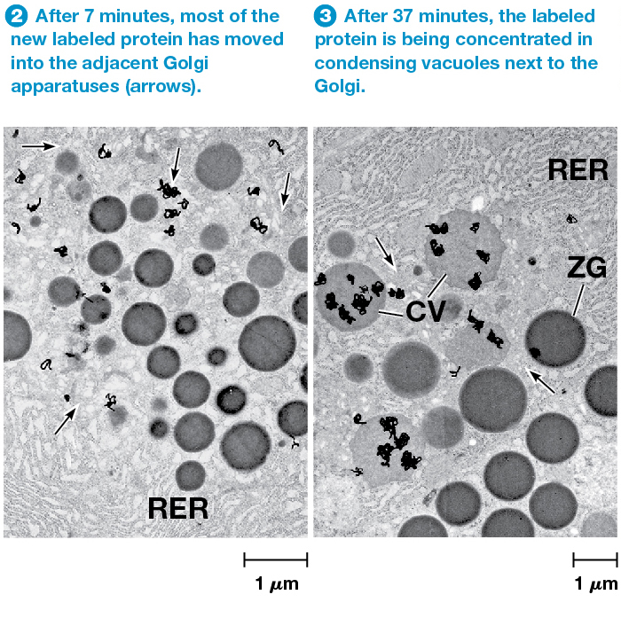
Autoradiographic Evidence of the Secretory Pathway: 7 and 37 Minutes After Radiolabeling
Figure 12.15 Autoradiographic Evidence of a Secretory Pathway.
Notes:
Long Description:
After 3 minutes, most of the labeled protein is found in the rough E R where it has just been synthesized.
After 7 minutes, most of the new labeled protein has moved into the adjacent Golgi apparatuses.
After 37 minutes, the labeled protein is being concentrated in condensing vacuoles next to the Golgi.
After 117 minutes, the labeled protein is found in zymogen granules, ready for export from the cell to the lumen.

Slide 67
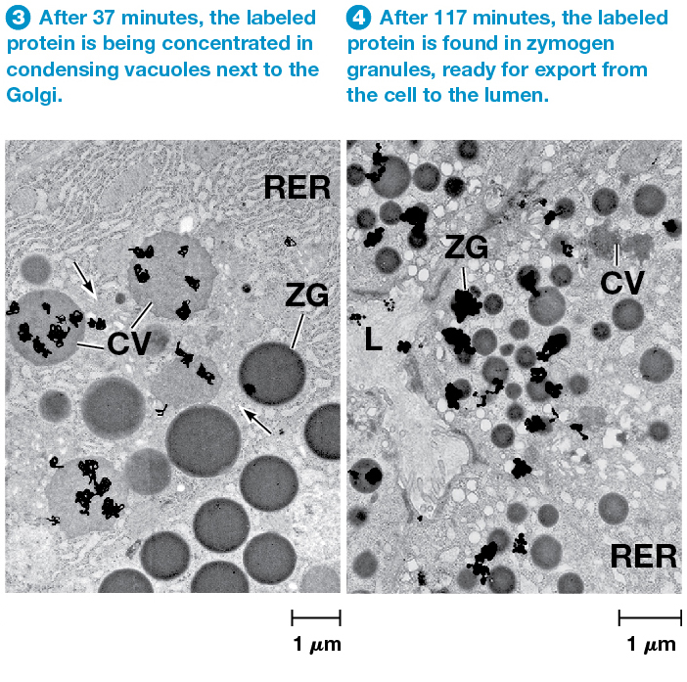
Autoradiographic Evidence of the Secretory Pathway: 37 and 117 Minutes After Radiolabeling
Figure 12.15 Autoradiographic Evidence of a Secretory Pathway.
Notes:
Long Description:
After 3 minutes, most of the labeled protein is found in the rough E R where it has just been synthesized.
After 7 minutes, most of the new labeled protein has moved into the adjacent Golgi apparatuses.
After 37 minutes, the labeled protein is being concentrated in condensing vacuoles next to the Golgi.
After 117 minutes, the labeled protein is found in zymogen granules, ready for export from the cell to the lumen.

Slide 68
Constitutive Secretion (1 of 2)
After budding from the T G N, some vesicles move directly to the cell surface and immediately fuse with the plasma membrane.
This unregulated process is continuous and independent of external signals.
It is called constitutive secretion; one example is mucus secretion by the intestinal lining.

Slide 69
Constitutive Secretion (2 of 2)
Constitutive secretion was once thought to be a default pathway for proteins synthesized by rough E R.
It was thought that proteins destined to stay in the endomembrane system must have a tag to avoid constitutive secretion.
Current evidence suggests that some tags may be required for constitutive secretion.

Slide 70
Regulated Secretion (1 of 2)
Secretory vesicles involved in regulated secretion accumulate in the cell and fuse with the plasma membrane only in response to specific signals.
An important example is neurotransmitter release.
Regulated secretory vesicles form by budding from the T G N as immature secretory vesicles.

Slide 71
Regulated Secretion (2 of 2)
Maturation of secretory proteins involves their concentration, called condensation, and sometimes proteolytic processing.
The mature secretory vesicles move close to the site of secretion and remain there until receiving a signal.
The signal triggers vesicles to release their contents by fusion with the plasma membrane.

Slide 72
Excluding Nonsecretory Proteins from Vesicles
Evidence suggests that high concentrations of secretory proteins lead to formation of protein aggregates.
These aggregates, formed in the T G N, act to exclude nonsecretory proteins from the forming secretory vesicles.
Proteins that do not form aggregates or enter secretory vesicles would be transported elsewhere.

Slide 73
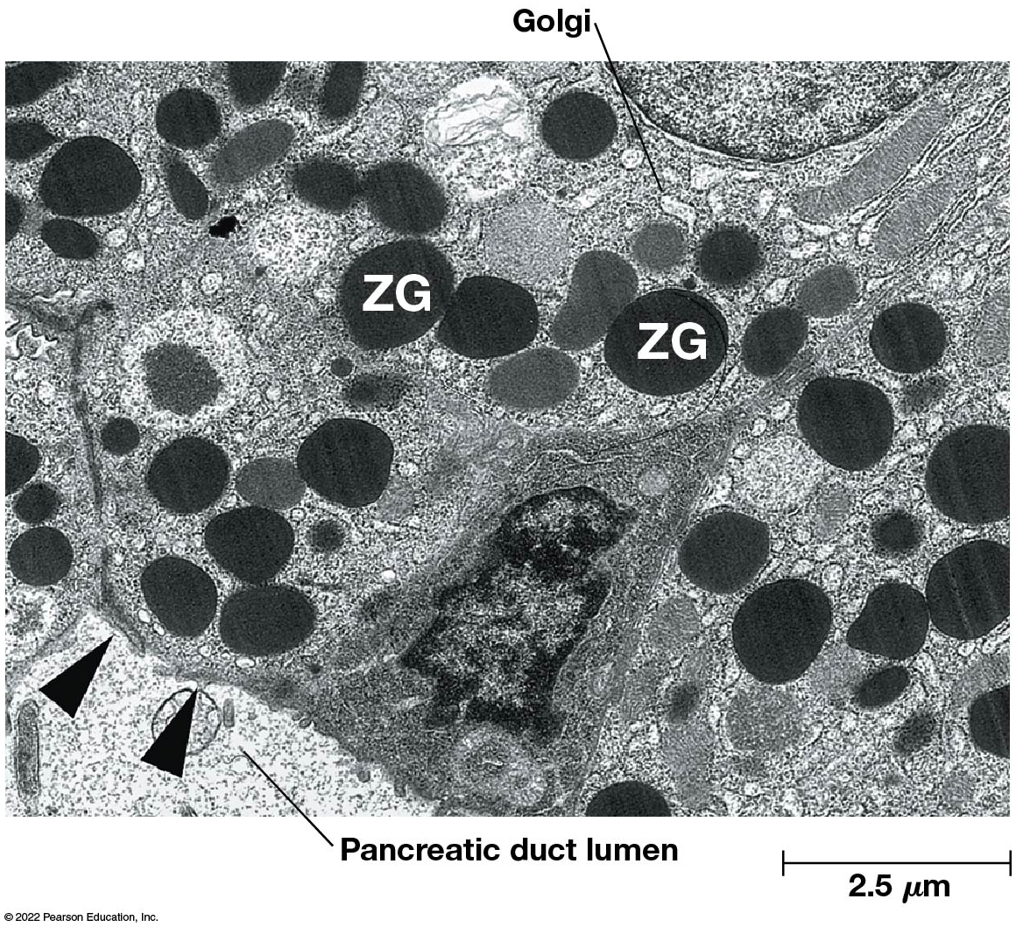
Zymogen Granules
Figure 12.16 Zymogen Granules.

Slide 74
Polarized Secretion
In many cases, exocytosis of specific proteins is limited to a specific surface of the cell.
For example, intestinal cells secrete digestive enzymes only on the side of the cell that faces into the intestine.
This is called polarized secretion.

Slide 75
Exocytosis Releases Intracellular Molecules Outside the Cell
In exocytosis, proteins in a vesicle are released to the exterior of the cell as the vesicle fuses with the plasma membrane.
Animal cells secrete hormones, mucus, milk proteins, and digestive enzymes this way.
Plant and fungal cells secrete enzyme and structural proteins for the cell wall.

Slide 76
The Process of Exocytosis
Vesicles containing products for secretion move to the cell surface.
The membrane of the vesicle fuses with the plasma membrane.
Fusion with the plasma membrane discharges the contents of the vesicle.
The membrane of the vesicle becomes part of the cell membrane. The inner (lumenal) surface of the vesicle becomes the outer (extracellular) surface.

Slide 77
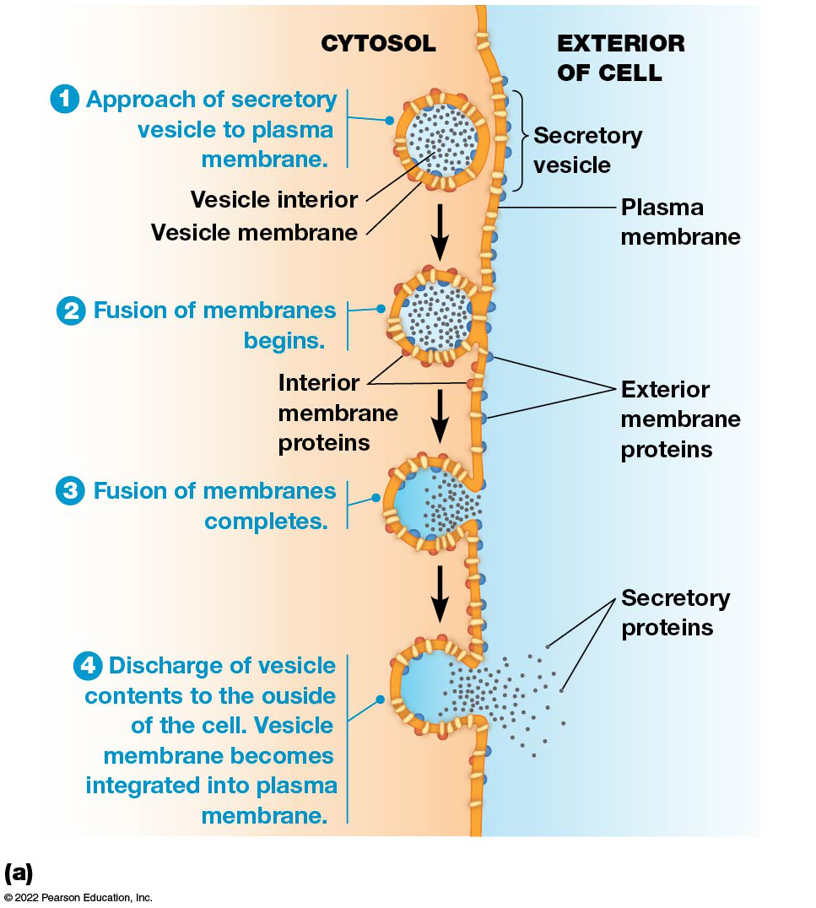
Exocytosis (1 of 2)
Figure 12.17 Exocytosis.
Notes:
Long Description:
The details are as below:
Approach of secretory vesicle to plasma membrane. The secretory vesicles are on the plasma membrane and also approaching toward it. The vesicle interior and vesicle membrane are labeled. The vesicle interior carries the secretory proteins.
Fusion of membranes begins. The vesicles adhere to the plasma membrane. The interior and exterior membrane proteins fuse.
Fusion of membranes completes. The plasma membrane opens to the exterior at the junction of secretory vesicles.
Discharge of vesicle contents, like secretory proteins, to the outside of the cell. Vesicle membrane becomes integrated into plasma membrane.
An electron micrograph shows multiple secretory vesicles approaching the plasma membrane. One of the vesicles has fused with the plasma membrane and secreted its contents outside the cell.

Slide 78
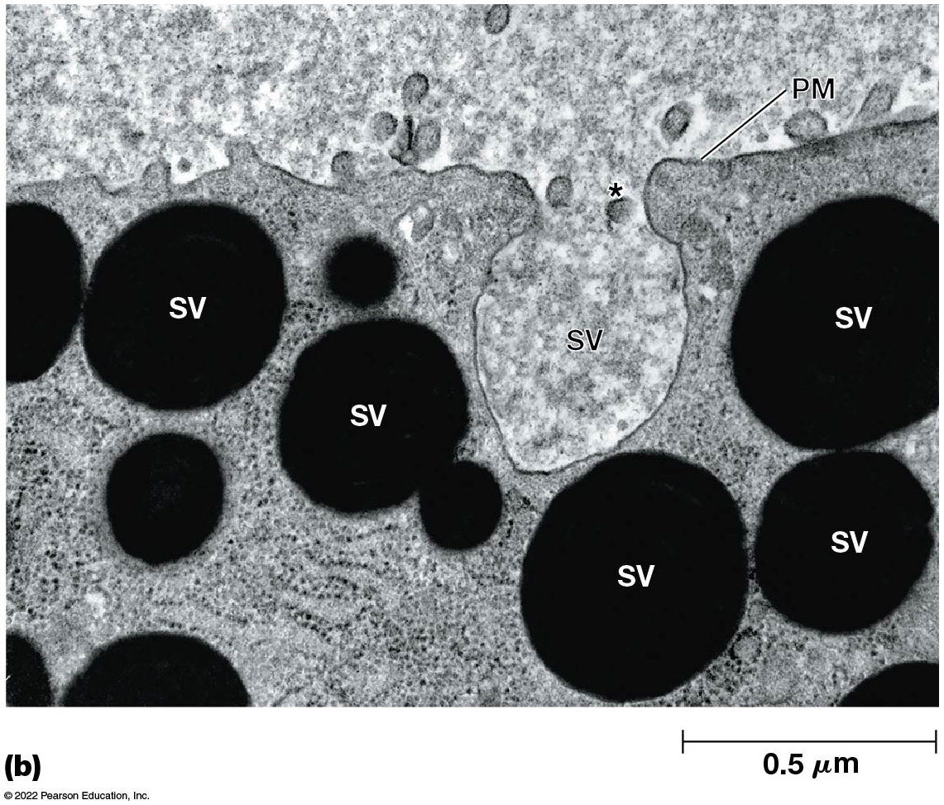
Exocytosis (2 of 2)
Figure 12.17 Exocytosis.
Notes:
Long Description:
The details are as below:
Approach of secretory vesicle to plasma membrane. The secretory vesicles are on the plasma membrane and also approaching toward it. The vesicle interior and vesicle membrane are labeled. The vesicle interior carries the secretory proteins.
Fusion of membranes begins. The vesicles adhere to the plasma membrane. The interior and exterior membrane proteins fuse.
Fusion of membranes completes. The plasma membrane opens to the exterior at the junction of secretory vesicles.
Discharge of vesicle contents, like secretory proteins, to the outside of the cell. Vesicle membrane becomes integrated into plasma membrane.
An electron micrograph shows multiple secretory vesicles approaching the plasma membrane. One of the vesicles has fused with the plasma membrane and secreted its contents outside the cell.

Slide 79
Orientation of Membrane
When the vesicle fuses with the plasma membrane:
The lumenal (inner) membrane of the vesicle becomes part of the outer surface of the plasma membrane
So, glycolipids and glycoproteins that were formed in the E R and Golgi lumens will face the extracellular space

Slide 80
Mechanism of Exocytosis
The mechanism of the movement of exocytic vesicles to the cell surface is not clear.
Evidence points to the involvement of microtubules in vesicle movement.
Vesicle movement stops when cells are treated with colchicine, a microtubule assembly inhibitor.

Slide 81
The Role of Calcium in Triggering Exocytosis
Fusion of regulated secretory vesicles with the plasma membrane is generally triggered by an extracellular signal.
In most cases, a hormone or neurotransmitter binds receptors on the cell surface and triggers a second messenger inside the cell.
A transient elevation in Ca²⁺ appears to be an essential step in the signaling cascade.

Slide 82
Endocytosis Imports Extracellular Molecules by Forming Vesicles from the Plasma Membrane
Most eukaryotic cells carry out one or more forms of endocytosis for uptake of extracellular material.
A small segment of the plasma membrane folds inward (step 1).
Then it pinches off to form an endocytic vesicle containing ingested substances or particles (steps 2–4).

Slide 83
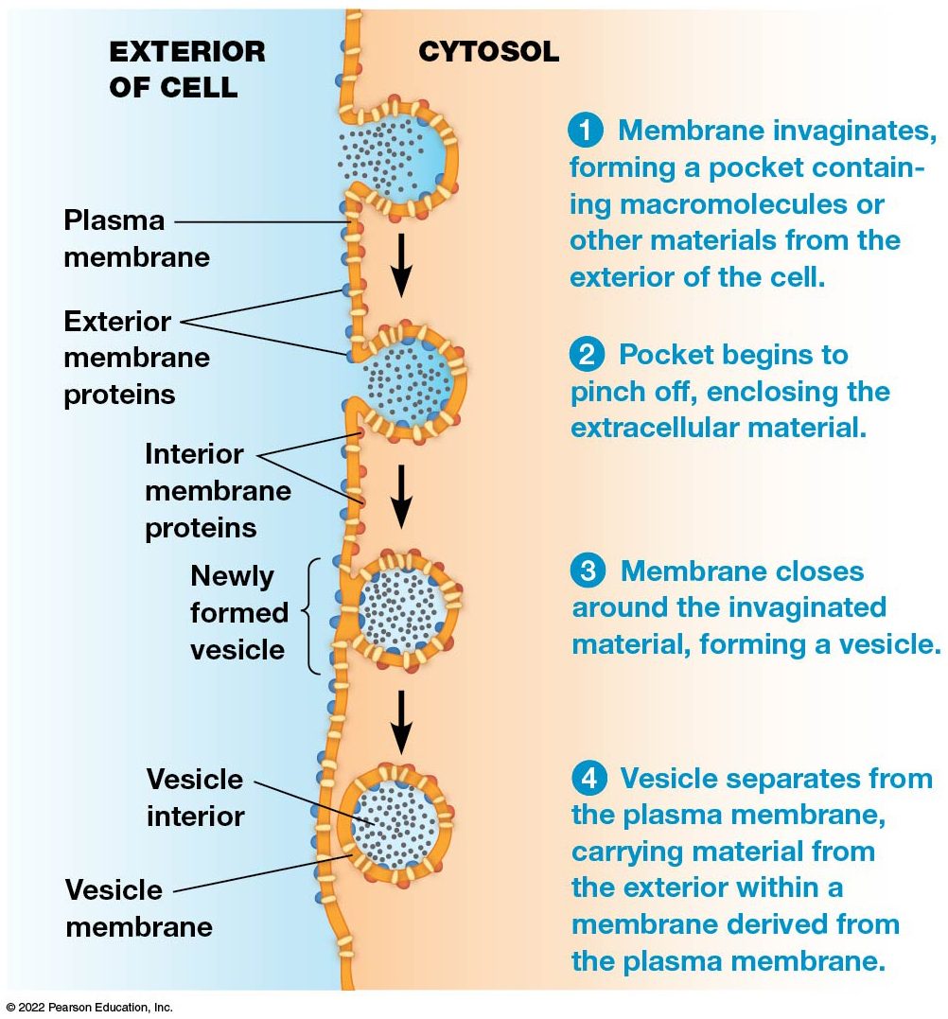
Endocytosis
Figure 12.18 Endocytosis.
Notes:
Long Description:
The details are as below:
Membrane invaginates, forming a pocket containing macromolecules or other materials from the exterior of the cell. Plasma membrane separates the cytosol from the exterior.
Pocket begins to pinch off, enclosing the extracellular material. The exterior membrane proteins are found on the exterior of the cell and the interior membrane proteins on the interior of the cell. The pockets begin closing after absorbing particles from the exterior of the cell.
Membrane closes around the invaginated material, forming a vesicle. The newly formed vesicles are closed ones lined by the interior membrane proteins in the cytosol.
Vesicle separates from the plasma membrane, carrying material from the exterior within a membrane derived from the plasma membrane. The vesicle interior carries the particles surrounded by the vesicle membrane.

Slide 84
Membrane Flow
Endocytosis and exocytosis have opposite effects in terms of membrane flow.
Exocytosis adds lipids and proteins to the plasma membrane, whereas endocytosis removes them.
The steady-state composition of the plasma membrane results from a balance between the two processes.

Slide 85
Endocytic Vesicles
Most endocytic vesicles develop into early endosomes, which fuse with vesicles from the T G N.
They acquire digestive enzymes and form new lysosomes.
In phagocytosis, solid particles are ingested.
In pinocytosis, liquids are taken up.

Slide 86
Selected Functions of Endocytosis
Maintaining normal cell homeostasis.
Bringing in nutrients.
Recycling cell receptors.
Protecting from bacterial invasion.
Communication with other cells.

Slide 87
Viruses Have Manipulated Endocytosis to Increase Infectivity
Some viruses:
Co-opt endocytic machinery to enter the cell.
Some viruses replicate their genome within the endocytic vesicle.
Some viruses encode fusion proteins that allow vesicles to uncoated and release the virus in the cytoplasm.

Slide 88
Phagocytosis
The ingestion of large particles up to and including whole cells or microorganisms is called phagocytosis.
For many unicellular organisms, it is a means of acquiring food.
For more complex organisms, it is usually restricted to specialized cells called phagocytes.

Slide 89
Phagocytes in Immune Function
In humans, two types of white blood cells use phagocytosis as a means of defense.
Neutrophils and macrophages engulf and digest foreign materials or invasive microorganisms found in the bloodstream or injured tissues.
Macrophages are also scavengers, ingesting cellular debris and damaged cells.

Slide 90
Phagocytes in the Amoeba (1 of 2)
Phagocytosis is most extensively studied in amoebae, which use it for nutrition.
Contact with food or other particles triggers the formation of pseudopods, folds of membrane.
These surround the object and engulf it, forming an intracellular phagocytic vacuole (phagosome).

Slide 91
Phagocytes in the Amoeba (2 of 2)
The phagosome fuses with a late endosome or matures directly into a lysosome.
In the lysosome, the engulfed material is digested.
In the human immune system, phagocytes generate toxic amounts of oxidants in the phagosome to kill microorganisms.

Slide 92
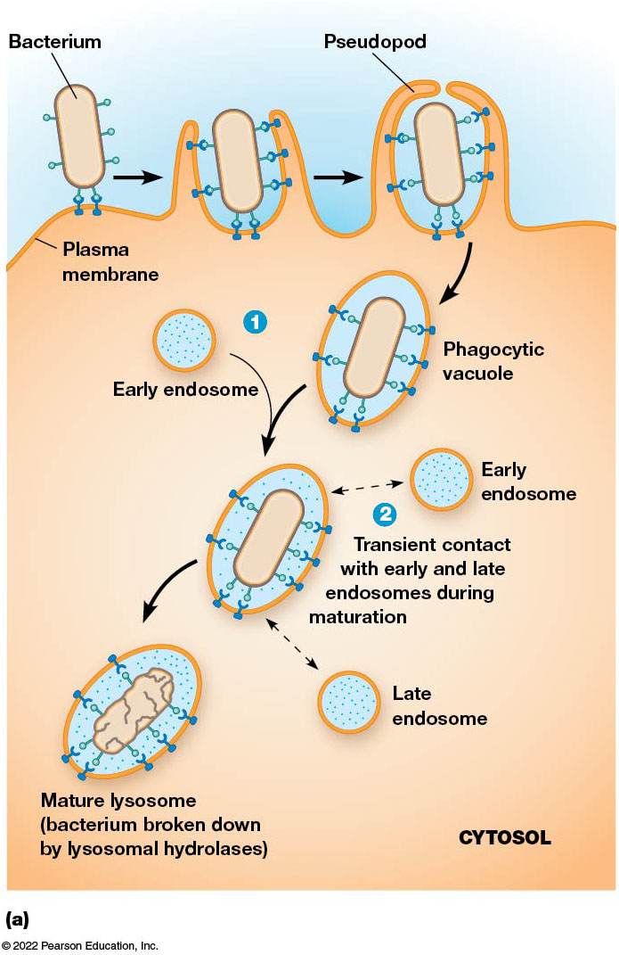
Phagocytosis (1 of 2)
Figure 12.19 Phagocytosis.
Notes:
Long Description:
The illustration shows the following steps:
Bacterium attached to plasma membrane. The plasma membrane forms a pseudopod around the bacterium.
The phagocytic vacuole fuses with an early endosome.
The phagocytic vacuole makes transient contact with early and late endosomes during maturation.
Mature lysosome causes bacterium to be broken down by lysosomal hydrolases.
An electron micrograph shows phagosome being formed by the pseudopod of amoeba encircling the green algal cell.

Slide 93
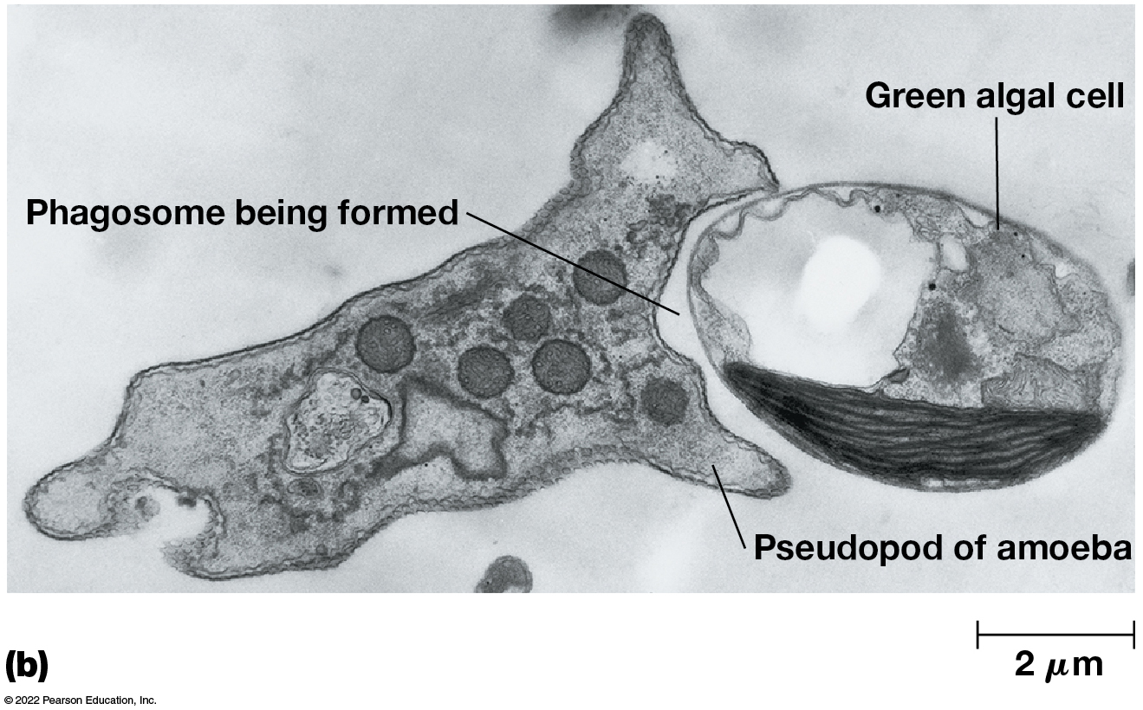
Phagocytosis (2 of 2)
Figure 12.19 Phagocytosis.
Notes:
Long Description:
The illustration shows the following steps:
Bacterium attached to plasma membrane. The plasma membrane forms a pseudopod around the bacterium.
The phagocytic vacuole fuses with an early endosome.
The phagocytic vacuole makes transient contact with early and late endosomes during maturation.
Mature lysosome causes bacterium to be broken down by lysosomal hydrolases.
An electron micrograph shows phagosome being formed by the pseudopod of amoeba encircling the green algal cell.

Slide 94
Receptor-Mediated Endocytosis (1 of 2)
Cells acquire some substances by receptor-mediated endocytosis (or clathrin-dependent endocytosis).
Cells use receptors on the outer cell surface to internalize many macromolecules.
Mammalian cells can ingest hormones, growth factors, serum proteins, enzymes, cholesterol, antibodies, iron, viruses, bacterial toxins.

Slide 95
Process of Receptor-Mediated Endocytosis (1 of 4)
Specific molecules (ligands) bind to their receptors on the outer surface of the cell.
Receptor-ligand complexes diffuse laterally and encounter specialized regions called coated pits, sites for collection and internalization of these complexes.
In a typical mammalian cell, coated pits occupy about 20% of the total surface area.

Slide 96
Process of Receptor-Mediated Endocytosis (2 of 4)
Accumulation of receptor-ligand complexes in the pits triggers the accumulation of additional proteins on the cytosolic surface of the membrane.
These proteins—adaptor protein, clathrin, dynamin—induce curvature and invagination of the pit.
Eventually, the pit pinches off, forming a coated vesicle.

Slide 97
Process of Receptor-Mediated Endocytosis (3 of 4)
The clathrin coat is released, leaving an uncoated vesicle.
The uncoated vesicle fuses with an early endosome.

Slide 98
Process of Receptor-Mediated Endocytosis (4 of 4)
Transport vesicles often:
Carry material to the late endosome and then a lysosome for digestion,
Recycle receptors to the plasma membrane, or
Transport material to the plasma membrane on the opposite side of the cell (transcytosis).

Slide 99
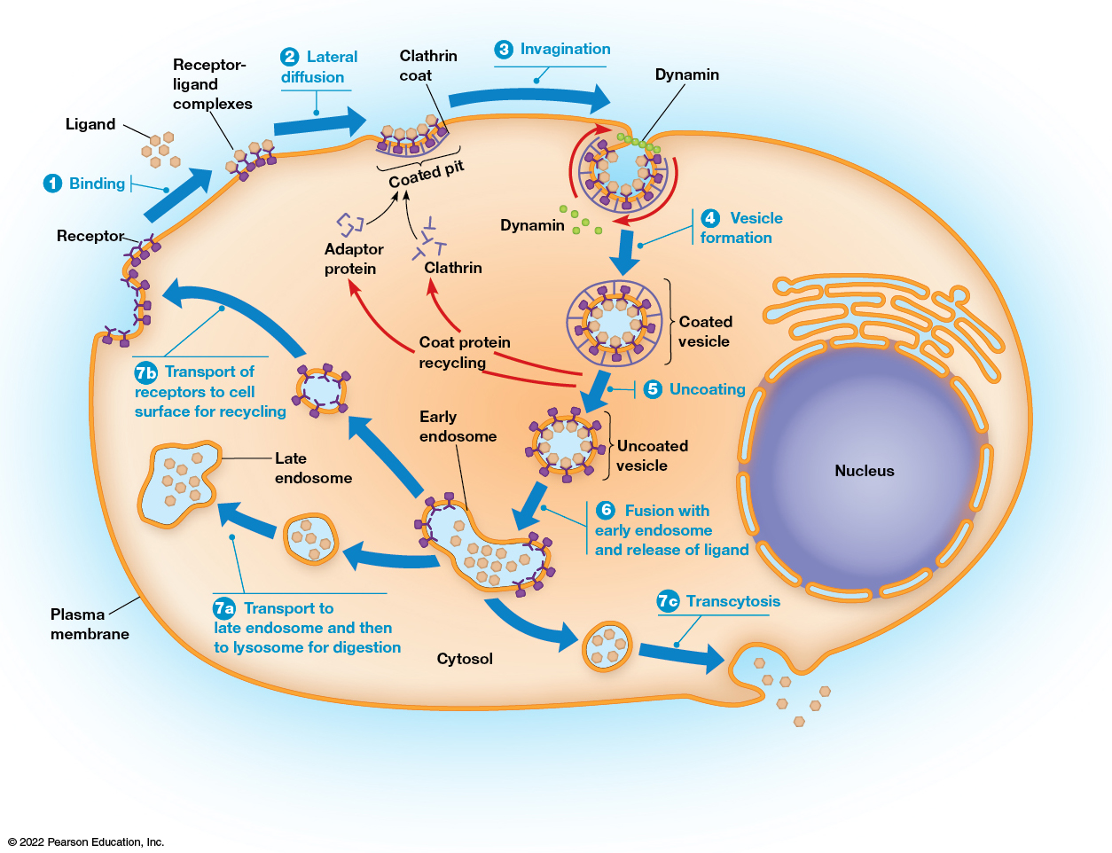
Receptor-Mediated Endocytosis (2 of 2)
Figure 12.20 Receptor-Mediated Endocytosis.
Notes:
Long Description:
The flow of processes is as below:
Binding: Ligand binding to receptor on the plasma membrane forming receptor hyphen ligand complexes.
Lateral diffusion: Clathrin coat being formed. A coated pit is formed.
Invagination: A pit is formed on the membrane with dynamin in it.
Vesicle formation: A coated vesicle with interior carrying particles and a membrane is formed.
Uncoating: The coat protein is recycled into adaptor protein and clathrin and forms the coated pit for the new vesicles to be formed. The uncoated vesicle moves to the next stage.
Fusion with early endosome and release of ligand: The uncoated vesicle fuses with an early endosome.
The transportation occurs in three types:
Transport to late endosome and then to lysosome for digestion is “7a”.
Transport of receptors to cell surface for recycling is “7b”.
Transcytosis is “7c”.

Slide 100
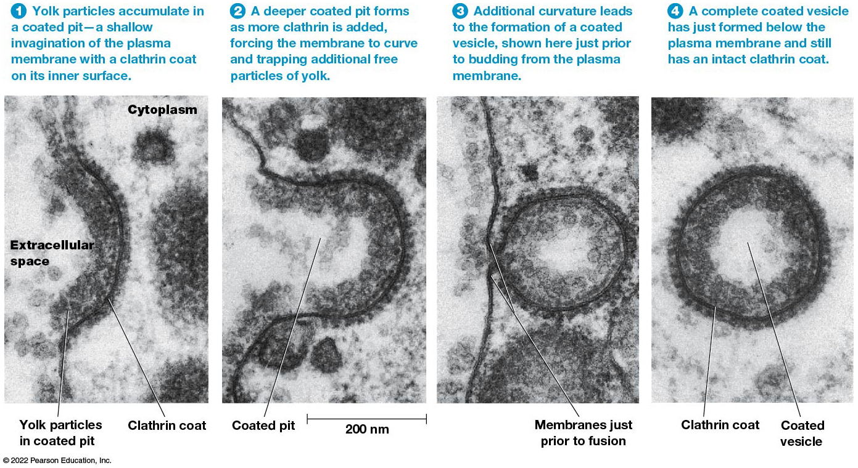
Receptor-Mediated Endocytosis of Yolk Protein by a Chicken Oocyte
Figure 12.21 Receptor-Mediated Endocytosis of Yolk Protein by a Chicken Oocyte.
Notes:
Long Description:
The steps are as below:
Yolk particles accumulate in a coated pit, a shallow invagination of the plasma membrane with a clathrin coat on its inner surface. The yolk particles in coated pit and clathrin coat are seen.
A deeper coated pit forms as more clathrin is added, forcing the membrane to curve and trapping additional free particles of yolk. A coated pit is formed and measurement shows 200 nanometers.
Additional curvature leads to the formation of a coated vesicle, shown here just before budding from the plasma membrane. The vesicle coating is in the process of closing to form a vesicle disjoint from the plasma membrane.
A complete coated vesicle has just formed below the plasma membrane and still has an intact clathrin coat. The coated vesicle with an outer clathrin coat is seen.

Slide 101
Variations of Receptor-Mediated Endocytosis (1 of 2)
Epidermal growth factor undergoes endocytosis and is a signal that stimulates cell division.
As E G F receptors are internalized, the cell becomes less responsive to E G F, a process known as desensitization.
Defective desensitization through failure to endocytose the receptor can lead to excess cell proliferation and possible tumor formation.

Slide 102
Variations of Receptor-Mediated Endocytosis (2 of 2)
Receptors may be concentrated in coated pits independent of ligand binding.
In this case, ligand binding triggers internalization.
In another variation (for example, L D L receptors), receptors are constitutively concentrated and constitutively internalized independent of ligand binding.

Slide 103
After Internalization
Uncoated vesicles fuse with vesicles budding from the TGN to form early endosomes.
Early endosomes are sites for sorting and recycling of materials brought into the cell.
Early endosomes continue to acquire lysosomal proteins from the TGN and mature to form late endosomes, which then develop into lysosomes.

Slide 104
Recycling Plasma Membrane Receptors
Receptors from the plasma membrane are recycled as a result of acidification of the early endosome.
The p H gradually declines as the endosome matures, facilitated by an A T P-dependent proton pump.
The lower p H dissociates ligand and receptors, allowing receptors to be returned to the membrane.

Slide 105
Alternative Fates for Receptor-Ligand Complexes
Some complexes are carried to a lysosome for degradation.
Some complexes are carried to the T G N, where they enter a variety of pathways in the endomembrane system.
Complexes can also travel by transport vesicles to a different region of the plasma membrane, where they are secreted (transcytosis).

Slide 106
Clathrin-Independent Endocytosis
Fluid-phase endocytosis is a type of pinocytosis for nonspecific internalization of extracellular fluid.
This process does not concentrate the ingested material, and contents are routed to early endosomes.
It proceeds at a constant rate and compensates for membrane segments added by exocytosis.

Slide 107
12.6 Coated Vesicles in Cellular Transport Processes
Most vesicles in protein and lipid transport are called coated vesicles because of the layers of proteins covering their cytosolic surfaces.
Coated vesicles are involved in vesicular traffic throughout the endomembrane system, as well as in exocytosis and endocytosis.
There are several types of coat proteins.

Slide 108
Coat Proteins
The most studied coat proteins are clathrin, C O P I, and C O P I I.
The type of coat protein on a vesicle helps to determine the destination of the vesicle.
They also induce curvature needed for the formation of the vesicles and prevent nonspecific fusion of the vesicle with another membrane.

Slide 109
Coated Vesicles Found Within Eukaryotic Cells
Table 12.2 Coated Vesicles Found Within Eukaryotic Cells
Coated Vesicle | Coat Proteins* | Origin | Destination
Clathrin | Clathrin, A P1, A R F | T G N | Endosomes
Clathrin | Clathrin, A P2 | Plasma membrane | Endosomes
C O P I | C O P I, A R F | Golgi apparatus | E R or Golgi apparatus
C O P I I | C O P I I (Sec13/31 and Sec23/24), Sar1 | E R | Golgi apparatus
Caveolin | Caveolin | Plasma membrane | E R?
*A R F designates A D P ribosylation factor 1; A P1 and A P2 designate different adaptor protein complexes (also called assembly protein complexes).

Slide 110
Caveolae
A recently discovered coat protein is caveolin.
Caveolin-coated vesicles are caveolae.
They are a type of lipid raft rich in cholesterol and sphingolipids and may be involved in cholesterol uptake by cells.

Slide 111
Clathrin-Coated Vesicles Are Surrounded by Lattices Composed of Clathrin and Adaptor Protein
Clathrin-coated vesicles are surrounded by coats made of two multimeric proteins, clathrin and adaptor protein (A P).
The shape of clathrin proteins and the way they assemble provides the driving force to induce a flat membrane to form a spherical vesicle.
The basic unit of clathrin lattices is a triskelion.

Slide 112
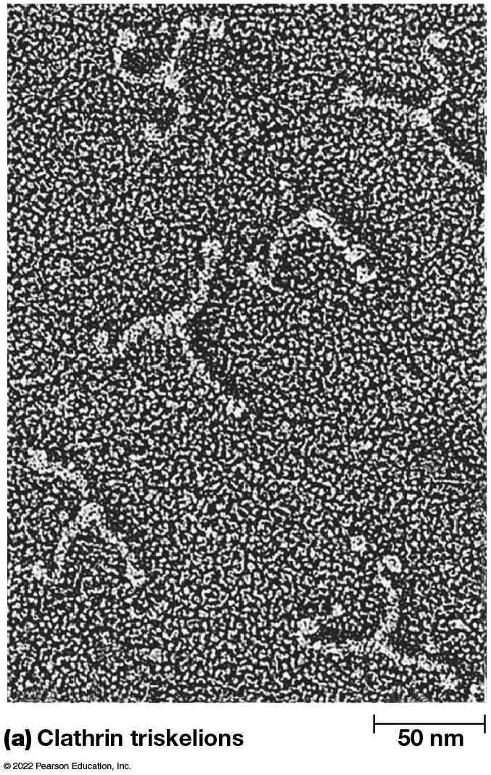
Clathrin Triskelions (1 of 3)
Figure 12.22 Clathrin Triskelions.
Notes:
Long Description:
The structure of clathrin triskelions consists of three arms of clathrin heavy chain starting from the vertex. Clathrin light chains are attached to the sides of the three arms. The heavy chains show a bend termed as knee. Each heavy chain ends in a terminal globular domain.
The model for assembly shows multiple individual clathrin triskelions joined together to form a hexagon or a pentagon. The process is reversible where multiple clathrin triskelions are separated out from a hexagon or pentagon.

Slide 113
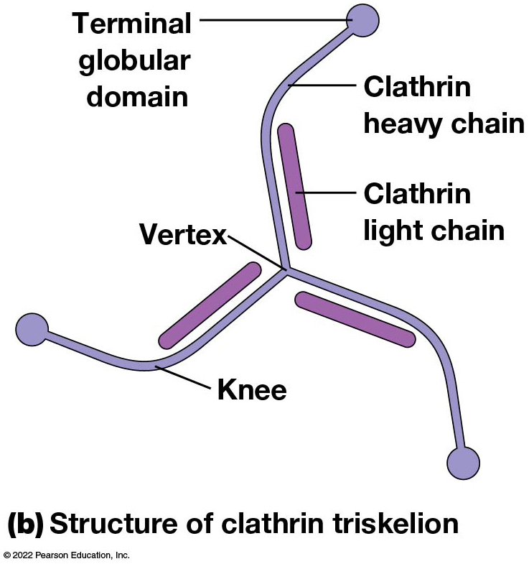
Clathrin Triskelions (2 of 3)
Figure 12.22 Clathrin Triskelions.
Notes:
Long Description:
The structure of clathrin triskelions consists of three arms of clathrin heavy chain starting from the vertex. Clathrin light chains are attached to the sides of the three arms. The heavy chains show a bend termed as knee. Each heavy chain ends in a terminal globular domain.
The model for assembly shows multiple individual clathrin triskelions joined together to form a hexagon or a pentagon. The process is reversible where multiple clathrin triskelions are separated out from a hexagon or pentagon.

Slide 114
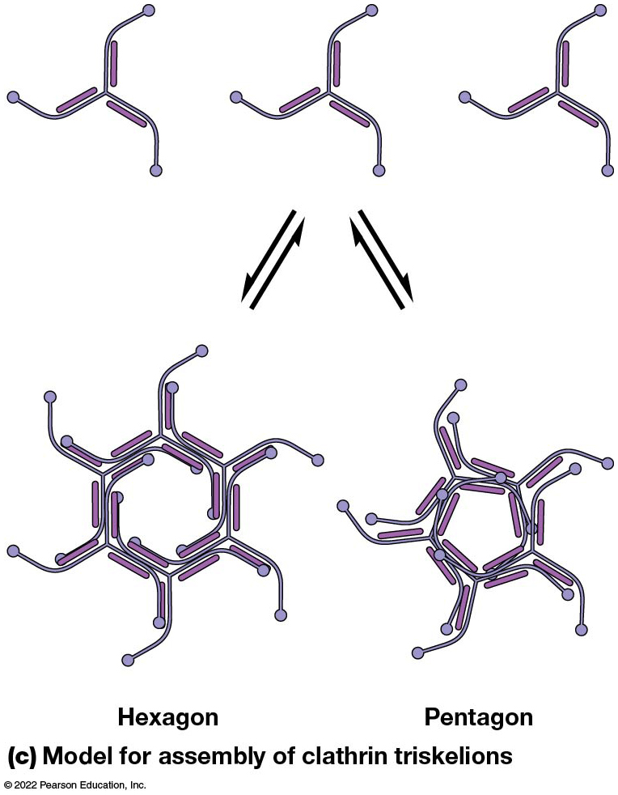
Clathrin Triskelions (3 of 3)
Figure 12.22 Clathrin Triskelions.
Notes:
Long Description:
The structure of clathrin triskelions consists of three arms of clathrin heavy chain starting from the vertex. Clathrin light chains are attached to the sides of the three arms. The heavy chains show a bend termed as knee. Each heavy chain ends in a terminal globular domain.
The model for assembly shows multiple individual clathrin triskelions joined together to form a hexagon or a pentagon. The process is reversible where multiple clathrin triskelions are separated out from a hexagon or pentagon.

Slide 115
Structure of a Triskelion
Each is a multimeric protein composed of three heavy chains and three light chains.
These radiate from a central vertex, with the light chains associated with the inner half of each “leg.”
Triskelions assemble into the hexagons and pentagons of the lattice around clathrin-coated pits and vesicles.

Slide 116
Adaptor Protein Complexes
The components of adaptor protein (AP) complexes were identified by their ability to promote assembly of clathrin coats around vesicles.
There are four types of AP complexes, each composed of four polypeptides: two of adaptin, one medium chain, and one small chain.
Each polypeptide binds to a different receptor.
AP complexes are sites of regulation of clathrin assembly and disassembly.

Slide 117
The Assembly of Clathrin Coats Drives the Formation of Vesicles from the Plasma Membrane and T G N
Binding of AP complexes to the plasma membrane and concentration of receptors or receptor-ligand complexes require A T P and G T P.
The assembly of the clathrin coat appears to provide some of the driving force for vesicle formation.

Slide 118
Clathrin Coat Assembly
Initially all clathrin units are hexagonal and form a planar structure.
As more triskelions are incorporated into the growing lattice, some pentagons are formed.
The mixture of pentagons and hexagons allows the new coat to curve around the budding vesicle.

Slide 119
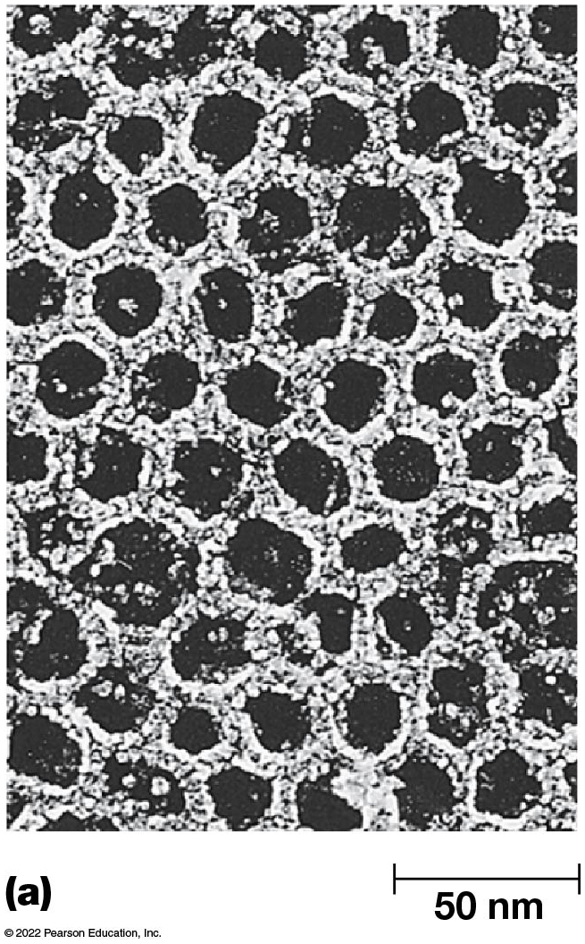
Clathrin Lattices (1 of 4)
Figure 12.23 Clathrin Lattices.
Notes:
Long Description:
The measurement of freeze etch electron micrograph of a hexagonal clathrin lattice is 50 nm. The structure is a close network of clathrin with heavy and light chains. The pentagonal and hexagonal units of measurement 500 nm show multiple such distinct units. The schematic drawings highlight single clathrin with knee, vertex, heavy, and light chains in a cage structure and a hexagonal structure.

Slide 120
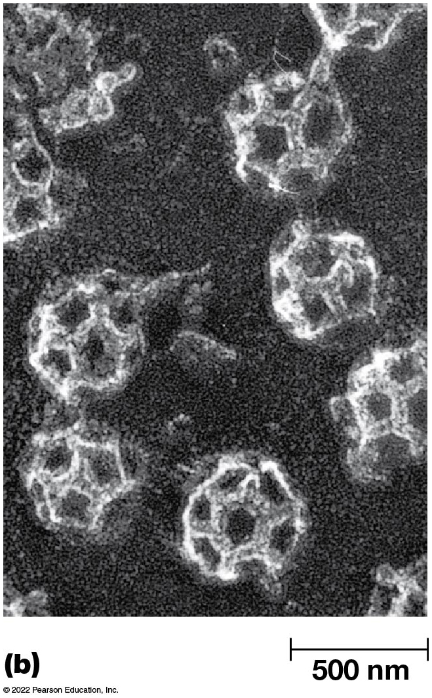
Clathrin Lattices (2 of 4)
Figure 12.23 Clathrin Lattices.
Notes:
Long Description:
The measurement of freeze etch electron micrograph of a hexagonal clathrin lattice is 50 nm. The structure is a close network of clathrin with heavy and light chains. The pentagonal and hexagonal units of measurement 500 nm show multiple such distinct units. The schematic drawings highlight single clathrin with knee, vertex, heavy, and light chains in a cage structure and a hexagonal structure.

Slide 121
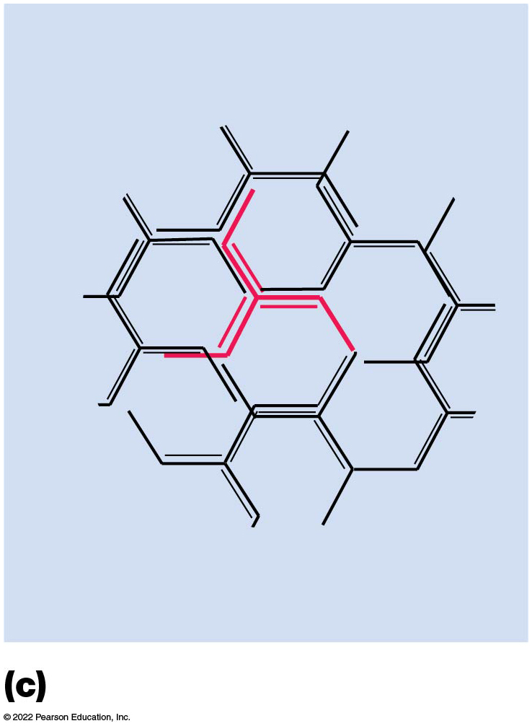
Clathrin Lattices (3 of 4)
Figure 12.23 Clathrin Lattices.
Notes:
Long Description:
The measurement of freeze etch electron micrograph of a hexagonal clathrin lattice is 50 nm. The structure is a close network of clathrin with heavy and light chains. The pentagonal and hexagonal units of measurement 500 nm show multiple such distinct units. The schematic drawings highlight single clathrin with knee, vertex, heavy, and light chains in a cage structure and a hexagonal structure.

Slide 122
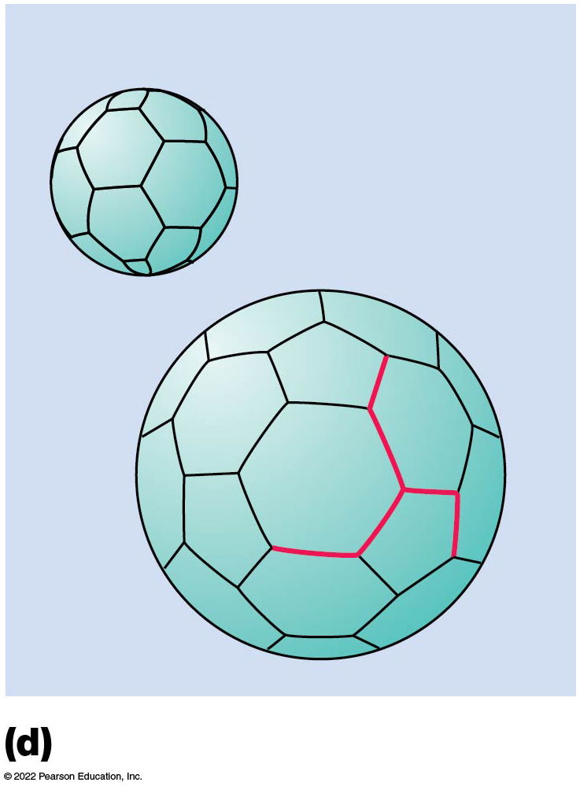
Clathrin Lattices (4 of 4)
Figure 12.23 Clathrin Lattices.
Notes:
Long Description:
The measurement of freeze etch electron micrograph of a hexagonal clathrin lattice is 50 nm. The structure is a close network of clathrin with heavy and light chains. The pentagonal and hexagonal units of measurement 500 nm show multiple such distinct units. The schematic drawings highlight single clathrin with knee, vertex, heavy, and light chains in a cage structure and a hexagonal structure.

Slide 123
Dynamin
As clathrin accumulates around the budding vesicle, dynamin is required for constricting and closing the vesicle.
Dynamin is a cytosolic GTPase; as GTP is hydrolyzed, dynamin rings tighten and separate the vesicle from the plasma membrane.

Slide 124
Uncoating the Vesicle
A mechanism is required to remove the clathrin coat (uncoat) from the newly formed vesicle.
Clathrin dissociates rapidly once the vesicle is formed.
Uncoating requires energy, provided by an uncoating A T Pase.

Slide 125
Clathrin Cages
In acidic conditions, with calcium present, clathrin can spontaneously form empty shells called clathrin cages.
Assembly and disassembly occur very quickly.

Slide 126
C O P I- and C O P I I-Coated Vesicles Travel Between the E R and Golgi Complex Cisternae
C O P I-coated vesicles are found in all eukaryotic cells examined and are involved in retrograde transport from the Golgi back to the E R as well as bidirectional transport between Golgi cisternae.
The vesicles are coated with C O P I and an A D P ribosylation factor (A R F), a small G T P-binding protein.
Assembly of the coat is mediated by A R F.

Slide 127
Role of A R F (1 of 2)
In the cytosol, A R F exists as part of an A R F - G D P complex.
Upon meeting a guanine nucleotide exchange factor associated with the membrane, the G D P is exchanged for G T P.
The resulting conformational change in A R F attaches it to the lipid bilayer.

Slide 128
Role of A R F (2 of 2)
Once firmly anchored, A R F binds C O P I multimers.
Assembly of the coat drives vesicle formation.
Once the vesicle is formed, a protein in the donor membrane triggers hydrolysis of G T P to G D P, a conformational change in A R F, and release of the coat.

Slide 129
C O PⅡ-Coated Vesicles
C O P Ⅱ-coated vesicles have a role in transport from the E R to the Golgi.
In yeast, the C O P Ⅱ coat is assembled from two protein complexes (Sec13/31 and Sec23/24) and a small G T P-binding protein called SarI.
SarI is similar to A R F, and the process of coat formation is similar to C O P I-coated vesicles.

Slide 130
S N A R E Proteins Mediate Fusion Between Vesicles and Target Membranes
Once vesicles form, additional proteins ensure delivery to the correct destination.
The S N A R E hypothesis provides a model for the sorting and targeting step of intracellular transport.
Proteins necessary for secretion include N-ethylmaleimide-sensitive factor (N S F) and soluble N S F attachment proteins (S N A P s).

Slide 131
S N A R E Proteins
Proper sorting and targeting of vesicles involves two families of S N A R E (S N A P receptor) proteins:
v-S N A R Es (vesicle-S N A P receptors) are found on vesicles
t-S N A R Es (target-S N A P receptors) are found on target membranes
v- and t-S N A R Es are complementary molecules that allow recognition between vesicles and their targets

Slide 132
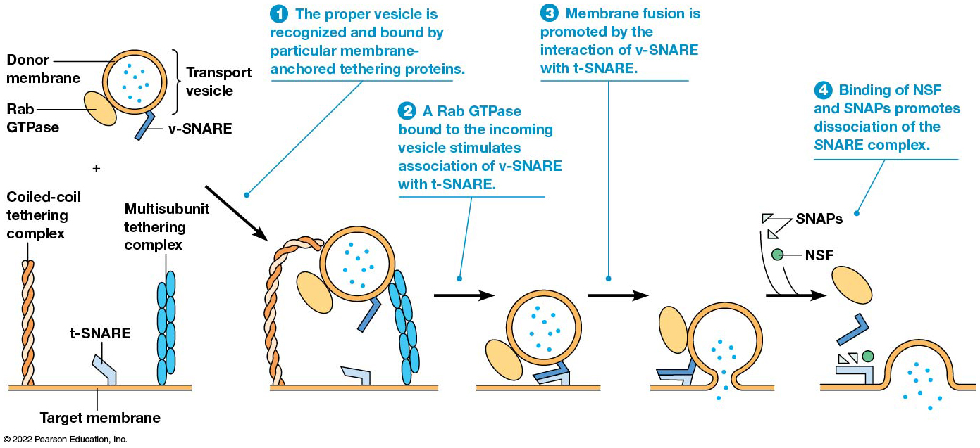
The S N A R E Hypothesis for Transport Vesicle Targeting and Fusion
Figure 12.24 The S N A R E Hypothesis for Transport Vesicle Targeting and Fusion.
Notes:
Long Description:
The process is as below:
The proper vesicle is recognized and bound by particular membrane hyphen anchored tethering proteins. The parts labeled in a transport vesicle are donor membrane, Rab G T Pase and v hyphen S N A R E attached to the outer membrane. The t hyphen S N A R E attaches to the target membrane. Coiled hyphen coil tethering complex and multi subunit tethering complex are also seen.
A Rab G T Pase bound to the incoming vesicle stimulates association of v hyphen S N A R E with t hyphen S N A R E. The v hyphen S N A R E is proceeding toward the t hyphen S N A R E on the target membrane.
Membrane fusion is promoted by the interaction of v hyphen S N A R E with t hyphen S N A R E.
Binding of N S F and S N A Ps promotes dissociation of the S N A R E complex. The particles inside the transport vesicle are released inside the target membrane.

Slide 133
Rab GTPases
When a vesicle reaches its destination, Rab GTPases (specific for different destinations) lock the complementary S N A R E proteins together.
This facilitates membrane fusion.

Slide 134
Release of S N A R E s
Following vesicle fusion, N S F and a group of SNAPs mediate release of the SNAREs of the donor and target membranes.
ATP hydrolysis may be needed, though its role is unclear.
NSF and SNAPs are nonspecific.

Slide 135
S N A R Es May Not Be the Whole Story
Recent research suggests that SNAREs are not solely responsible for targeting specificity.
Tethering proteins act over longer distances and attach vesicles to their targets before the SNAREs interact.
Chemical blocking of SNARE complex formation does not abolish vesicle-target interaction.

Slide 136
Tethering Proteins
Two main groups of tethering proteins are coiled-coil proteins and multisubunit complexes.
Coiled-coil proteins such as golgins are important in recognition and binding of C O P I or C O P Ⅱ vesicles to the Golgi.
Multisubunit protein complexes such as the exocyst complex are important for protein secretion.

Slide 137
12.7 Lysosomes and Cellular Digestion
The lysosome is an organelle of the endomembrane system that contains digestive enzymes.
It can degrade all the major classes of biological macromolecules:
Lipids, carbohydrates, nucleic acids, and proteins

Slide 138
Lysosomes Isolate Digestive Enzymes from the Rest of the Cell
Lysosomes contain acid phosphatase and several other hydrolytic enzymes.
They vary in size and shape but are usually about 0.5 µm in diameter, bounded by a single membrane.
The lumenal side of the membrane is coated with glycoproteins to protect the membrane from degradation.

Slide 139
Lysosomes Are Highly Acidic Inside
Lysosomes maintain an acidic environment (pH 4.0–5.0) inside.
A T P-dependent proton pumps in the membrane are responsible for this.
There are numerous enzymes inside lysosomes; all are acid hydrolases.

Slide 140
Lysosomes Develop from Endosomes
Lysosomal enzymes are synthesized by ribosomes on rough E R and translocated inside.
Lysosomal enzymes are delivered from the T G N to endosomes in transport vesicles.
Over time, endosomes mature into late endosomes, with all the enzymes, but not engaged in digestion.

Slide 141
Endosome Development
The pH of the early endosome lumen drops from about 6.0 to 5.5.
The endosome loses its ability to fuse with endocytic vesicles.
The late endosome is packaged with material to be digested and newly synthesized digestive enzymes.
This protects the cell from hydrolytic enzymes.

Slide 142
Final Step of Lysosome Development
The last step in development of a lysosome is activation of the acid hydrolases.
This occurs as the internal environment becomes more acidic (pH 4.0–5.0).
This occurs through the pumping of protons or through fusion with an existing lysosome.

Slide 143
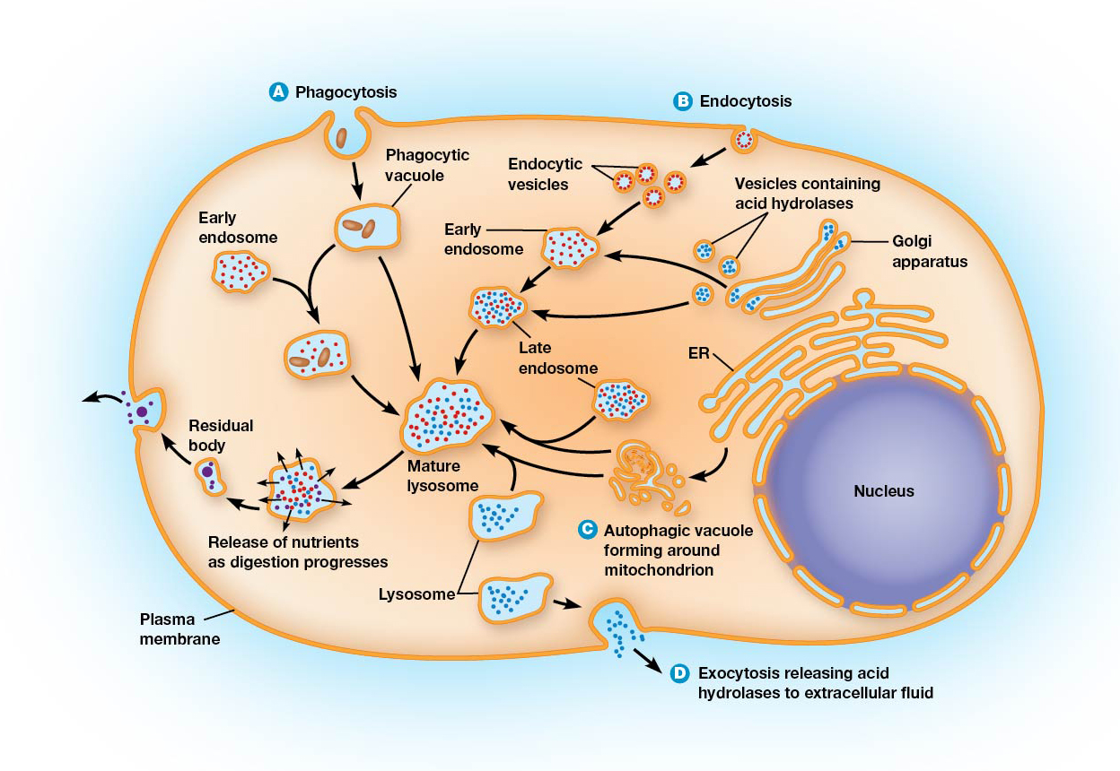
The Formation of Lysosomes and Their Roles in Cellular Digestive Properties
Figure 12.25 The Formation of Lysosomes and Their Roles in Cellular Digestive Processes.
Notes:
Long Description:
The processes are as below:
Phagocytosis: Phagocytic vacuole with or without early endosome to mature lysosome.
Endocytosis: endocytic vesicles to early endosomes to late endosome to mature lysosome. Additionally, multiple late endosomes contribute to mature lysosomes.
Another pathway is Golgi apparatus to vesicles containing acid hydrolases to early endosomes to late endosomes to mature endosomes.
Endoplasmic reticulum to autophagic vacuole forming around mitochondrion to mature lysosome.
In all the above pathways, the mature lysosomes become lysosomes and release acid hydrolases to extracellular fluid by the process of exocytosis. Also, mature lysosomes release nutrients as digestion progresses, creates residual body, and release the particles to the exterior of the cell. Nucleus and plasma membrane are labeled.

Slide 144
Lysosomal Enzymes Are Important for Several Different Digestive Properties
Lysosomes containing substances that originated outside the cell are called heterophagic lysosomes.
Those with materials that originated inside the cell are called autophagic lysosomes.

Slide 145
Phagocytosis and Receptor-Mediated Endocytosis: Lysosomes in Defense and Nutrition
The degradation of external materials brought into the cell by phagocytosis and receptor-mediated endocytosis.
Phagocytic vacuoles become lysosomes by fusion with endosomes.
Vesicles formed by receptor-mediated endocytosis fuse with vesicles of the TGN containing acid hydrolases.

Slide 146
After Digestion Is Complete
Eventually, indigestible material is all that remains in a lysosome.
The lysosome becomes a residual body when digestion ceases.
Some cells release the contents by exocytosis; in others, accumulation of debris may contribute to cellular aging.

Slide 147
Autophagy: A Biological Recycling System
Cellular structures that are damaged or unneeded must be broken down via autophagy.
Macrophagy: an organelle is wrapped in a double membrane derived from the E R, forming an autophagic vacuole (autophagosome).
Microphagy: a much smaller vacuole is formed, surrounded by a single-membrane bilayer.

Slide 148
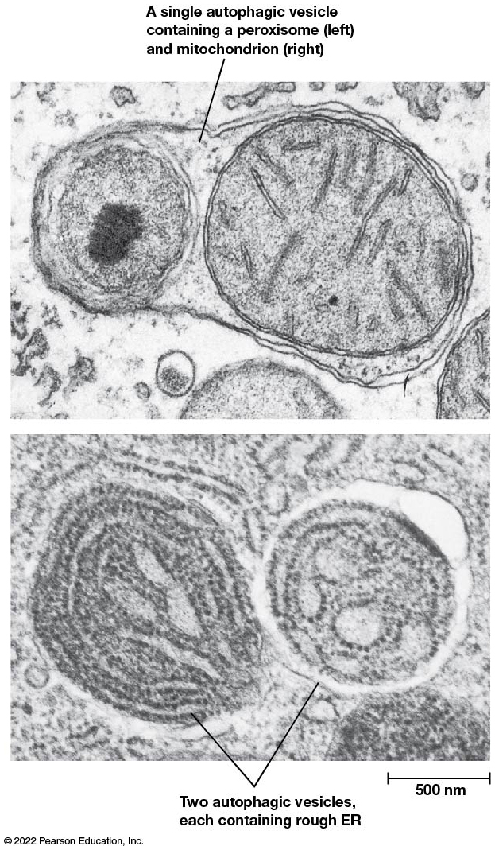
Autophagic Digestion
Figure 12.26 Autophagic Digestion.
Notes:
Long Description:
The first micrograph shows a single autophagic vesicle containing peroxisome to the left and mitochondrion to the right. Another micrograph shows two autophagic vesicles, each containing rough E R.

Slide 149
Autophagy and Cancer
Recent works suggests a direct link between autophagy and cancer.
In mice, knockout of a gene required for autophagy in yeast causes decrease in autophagy and an increase in breast and lung tumors.

Slide 150
Extracellular Digestion
Most lysosomal digestion occurs inside the cell.
In some cases, lysosomes discharge their contents outside the cell, resulting in extracellular digestion.
For example, the head of a sperm releases digestive enzymes to degrade barriers protecting an egg.

Slide 151
Lysosomal Storage Diseases Are Usually Characterized by the Accumulation of Indigestible Material
Over 40 lysosomal storage diseases are known, in which certain lysosomal proteins are absent.
The diseases are characterized by the accumulation of substances that cannot be broken down as needed.
Most are not treatable yet.

Slide 152
Examples of Lysosomal Storage Diseases
Type Ⅱ glycogenosis—accumulation of excessive glycogen.
Hurler syndrome, Hunter syndrome—accumulation of glycosaminoglycans.
Tay-Sachs disease—accumulation of a ganglioside in the nervous system.

Slide 153
Treatment of Lysosomal Storage Diseases
Lysosomal storage diseases can be diagnosed prenatally.
It is hoped that treatments that replace the missing enzyme will be developed.
This is known as enzyme replacement therapy.
Or, altering the D N A of patients (gene therapy) is another possible approach.

Slide 154
The Plant Vacuole: A Multifunctional Digestive Organelle
Plant cells have acidic vacuoles that perform the function of lysosomes.
However, these have additional roles as well.
Vacuole development is similar to that of lysosomes, with coated vesicles conveying materials for the vacuole to a provacuole, similar to an endosome.

Slide 155
Additional Functions of Vacuoles (1 of 2)
Vacuoles mature to form a structure that can fill up to 90% of the cell’s total volume.
Vacuoles maintain turgor pressure, the osmotic pressure preventing plant cells from collapsing.
They regulate cytosolic p H, using A T P-dependent proton pumps.

Slide 156
Additional Functions of Vacuoles (2 of 2)
Vacuoles serve as a storage compartment for such substances as
Seed storage proteins
Malate (in C A M plants)
Anthocyanins
Toxic component to deter predators
Soluble and insoluble waste

Slide 157
12.8 Peroxisomes
Peroxisomes are bounded by single membranes.
These membranes were not originally thought to be supplied by the ER, but growing evidence suggests the ER supplies membrane for growth and division.
Thus, they can be discussed as part of the endomembrane system.
The defining characteristic of peroxisomes is the presence of catalase for degrading H₂O₂.

Slide 158
Peroxisome Structure
Animal peroxisomes contain a crystalline core, consisting of crystalline urate oxidase.
Plant peroxisomes may contain crystalline catalase.
Peroxisomes without the crystalline cores may be difficult to identify microscopically.

Slide 159
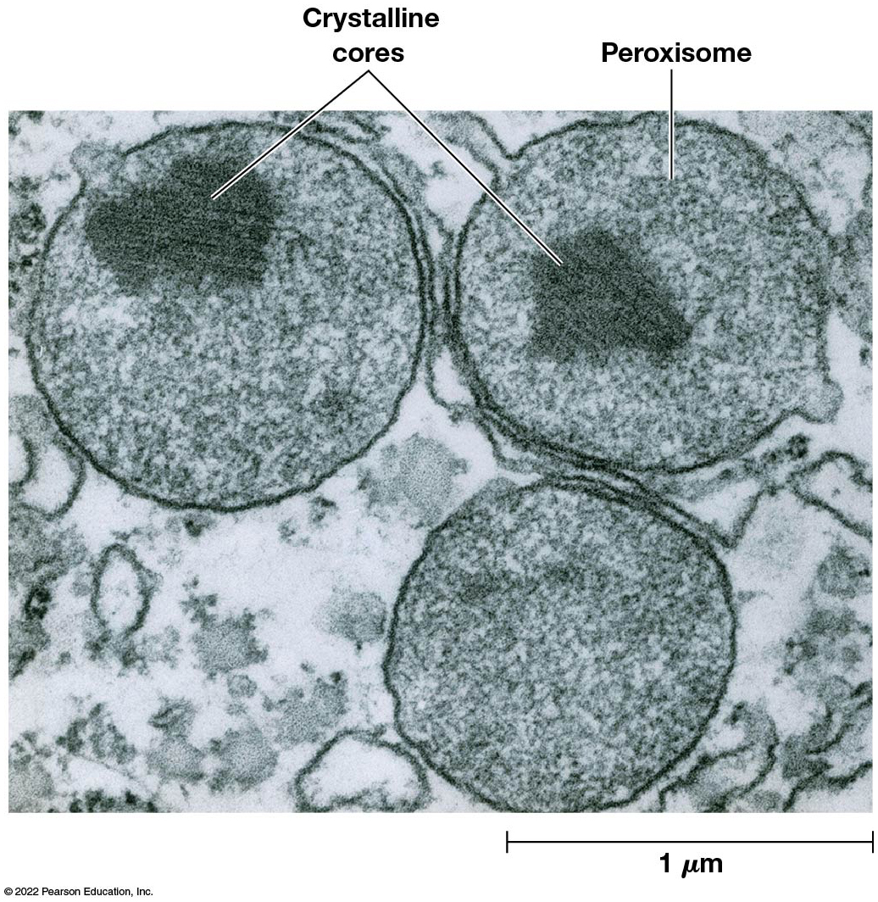
Peroxisomes in Animal Cells
Figure 12.27 Peroxisomes in Animal Cells.

Slide 160
Chemical Identification of Peroxisomes in Plant Cells
Catalase oxidizes diaminobenzidine (D A B) to a form that causes deposition of osmium ions.
These electron-dense deposits can be seen via electron microscopy.

Slide 161
Most Peroxisomal Functions Are Linked to Hydrogen Peroxide Metabolism
The essential roles of peroxisomes include:
Hydrogen peroxide metabolism
Detoxification of harmful compounds
Oxidation of fatty acids
Metabolism of nitrogen-containing compounds
Catabolism of unusual substances

Slide 162
Hydrogen Peroxide Metabolism
Oxidases generate H₂O₂ in peroxisomes
The hydrogen peroxide is detoxified by catalase
Where R H₂ represents an oxidizable substance.
Notes:
Long Description:

Slide 163
Hydrogen Peroxide Can Be Detoxified Another Way
Alternatively, catalase can function as a peroxidase
The result is the same in either case—hydrogen peroxide is degraded while still inside the peroxisome.

Slide 164
Detoxification of Harmful Compounds
Peroxidase can use methanol, ethanol, formic acid, formaldehyde, nitrates, and phenols (all toxic) as electron donors. This oxidative detoxification protects the cell.
Peroxisomes detoxify reactive oxygen species. If these accumulate, they can cause oxidative stress.
Peroxisomal enzymes such as superoxide dismutase and others detoxify reactive oxygen species.

Slide 165
Oxidation of Fatty Acids
Peroxisomes contain enzymes for β oxidation of fatty acids.
In animals, the primary product of β oxidation, acetyl-CoA, is exported to the cytosol and enters biosynthetic pathways or the citric acid cycle.
In plants and yeast, fatty acids are completely oxidized in peroxisomes.

Slide 166
Metabolism of Nitrogen-Containing Compounds
Most animals (not primates) require urate oxidase to oxidize urate, formed during catabolism of nucleic acids and some proteins.
The H₂O₂ is immediately degraded by catalase.

Slide 167
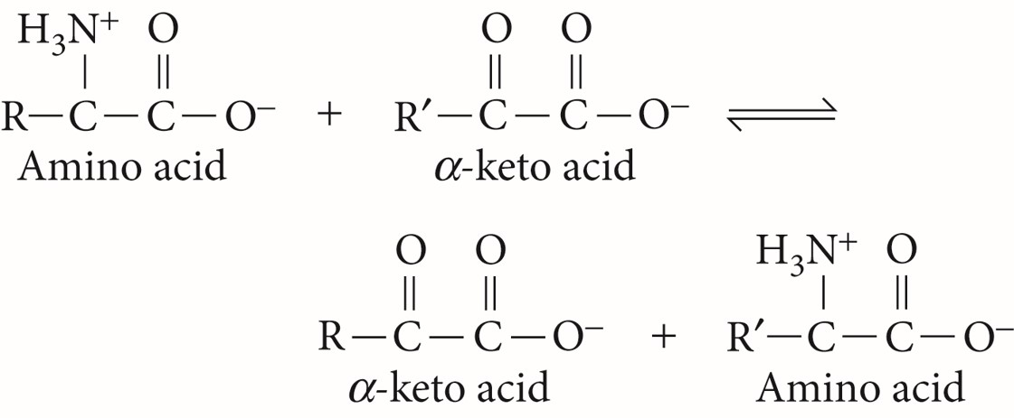
Aminotransferases
Aminotransferases catalyze the transfer of amino groups from amino acids to α-keto acids in the degradation and synthesis of amino acids

Slide 168
Catabolism of Unusual Substances
D-amino acids are rare substances for which the cell has no degradative pathways, except in the peroxisome.
In some cells, peroxisomes also contain enzymes that break down xenobiotics, compounds foreign to living organisms.
This includes short-chain hydrocarbons such as alkanes.

Slide 169
Peroxisomal Disorders
A large number of disorders arise from defects in peroxisomal proteins.
The most common is X-linked adrenoleukodystrophy.
The defective protein in this case may be responsible for transporting long-chain fatty acids into the peroxisome for degradation.

Slide 170
Plant Cells Contain Types of Peroxisomes Not Found in Animal Cells
In plants and algae, peroxisomes are involved in several aspects of cell energy metabolism.

Slide 171
Leaf Peroxisomes
Cells of photosynthetic tissues contain leaf peroxisomes in close contact with mitochondria and chloroplasts.
They are involved in the glycolate pathway, also called the photorespiratory pathway.

Slide 172
Glyoxysomes
Glyoxysomes occur transiently in seedlings.
They contain enzymes needed to convert stored triacylglycerols to sucrose, β oxidation of fatty acids, and the glyoxylate cycle.
They are found only in tissues where fat is stored, and when no longer needed they are converted to peroxisomes.

Slide 173
Peroxisome Biogenesis Occurs by Division of Preexisting Peroxisomes or by Vesicle Fusion
Peroxisomes increase in number as cells grow and divide; this proliferation is biogenesis.
Proteins required for this process are peroxins.
Peroxisomes are also formed by fusion of vesicles budding from the Golgi apparatus and by division of existing peroxisomes.

Slide 174
Peroxisome Biogenesis (1 of 2)
Lipids and membrane proteins can be added to peroxisomes via cytosolic sources.
Polypeptides for peroxisomal matrix enzymes are synthesized on cytosolic ribosomes and are threaded through the membrane via transmembrane peroxin transport protein.
Heme enters the peroxisomal lumen via a separate pathway and the catalase polypeptides are folded and assembled.

Slide 175
Peroxisome Biogenesis (2 of 2)
After new lipids and proteins are added, new peroxisomes are formed by the division of existing peroxisomes.
Recent evidence suggests peroxisomes can obtain new proteins or form de novo from vesicles from the E R.

Slide 176
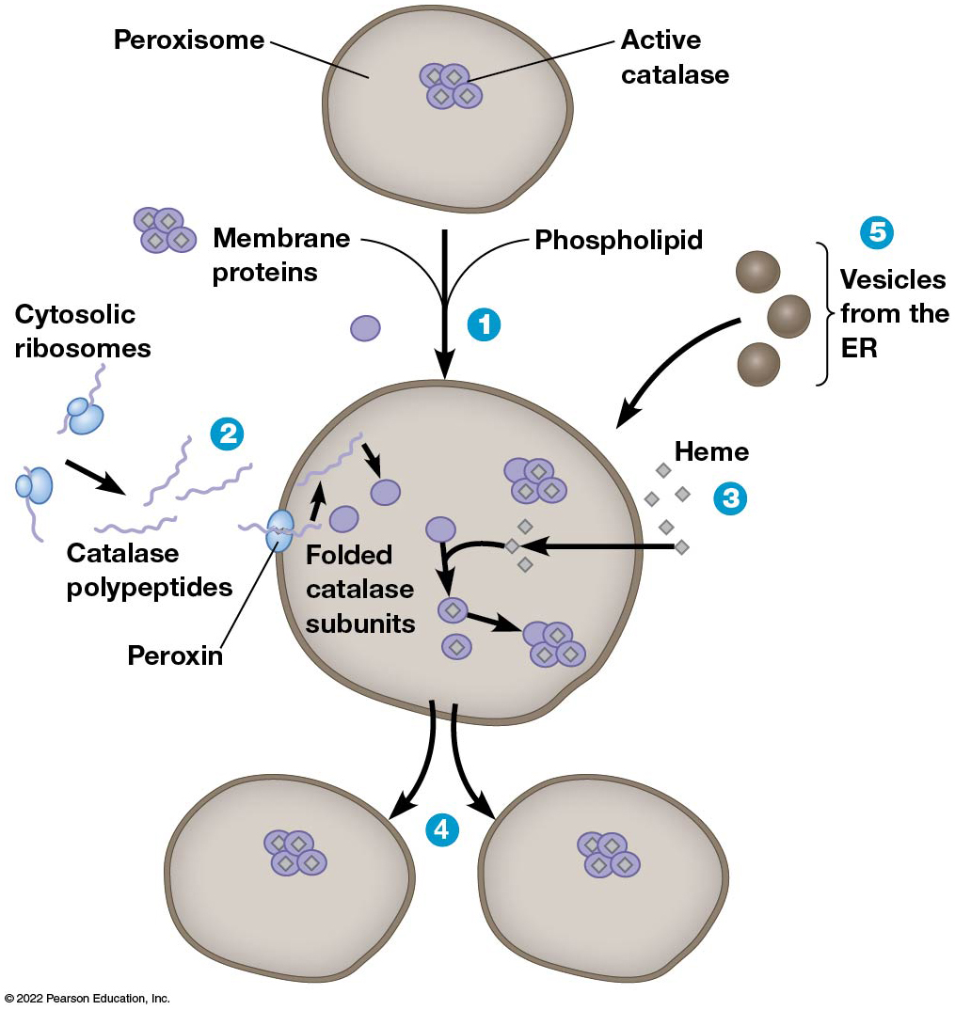
Biogenesis of Peroxisomes and Protein Import
Figure 12.28 Biogenesis of Peroxisomes and Protein Import.
Notes:
Long Description:
The processes are as below:
1. Phospholipid and membrane proteins are added to peroxisomes.
2. The parts labeled are cytosolic ribosomes, catalase polypeptides, peroxin on the membrane, and folded catalase subunits.
3.Heme acts as cofactors to the peroxisome.
4. New peroxisomes are formed by the division from existing peroxisomes.
5. Additionally, vesicles from the E R supply proteins to the existing peroxisomes.

